Slide 1

Dynamic Generation of Modular Industrial Plant Visualizations
Weekly Meeting 9
Miguel Romero Karam

Slide 2
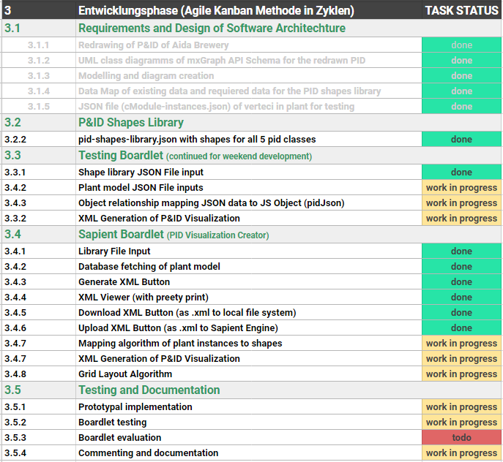
Task Backlog – Overview Overview of tasks: Week 9

Slide 3
Task Backlog – Overview Overview of tasks: Week 9

Slide 4
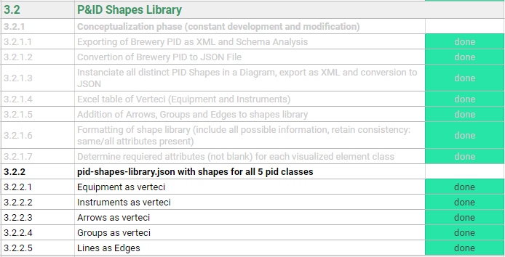
P&ID Shapes Library Weekly Sprint 9
Changes to equipment
Size modifications to be made (defaults left for now)
Arrows and groups defined in library but won’t be implemented for now
Groups are defined in l_nodes, they will serve for inclusion graphing algorithm
4 shape types defined. shapeName defines line type:
 | 1 | pipe_line
 | 2 | connection_line
 | 3 | signal_line
 | 4 | data_line

Slide 5
Task Backlog – Overview Overview of tasks: Week 9

Slide 6
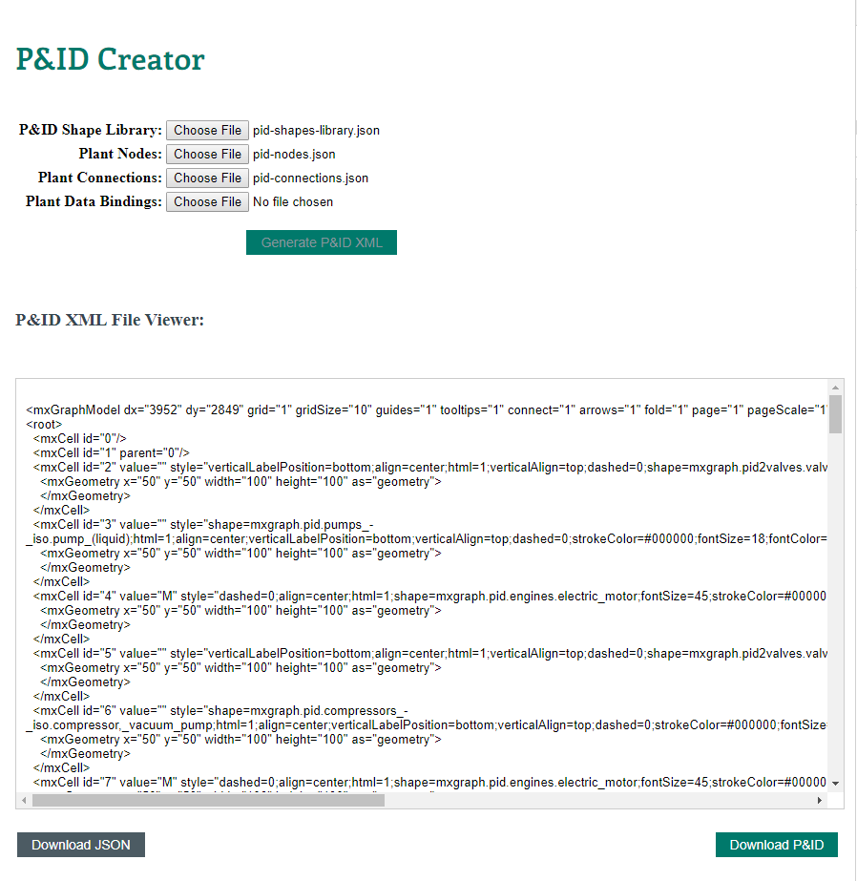
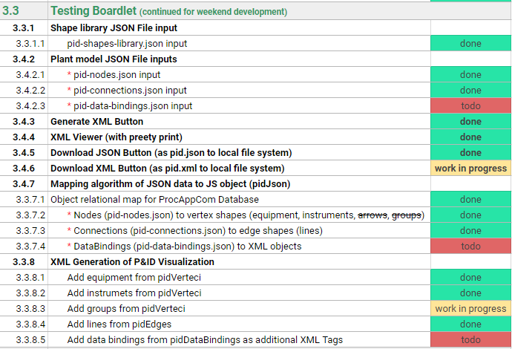
Testing Boardlet Weekly Sprint 9
In client- background
Allows work during weekend
Allows testing with json data * (instead of database fetches)
Separation of concerns. 3 DB fetches → 3 separate json file inputs for model

Slide 7

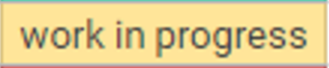
Task Backlog – Overview Overview of tasks: Week 9

Slide 8
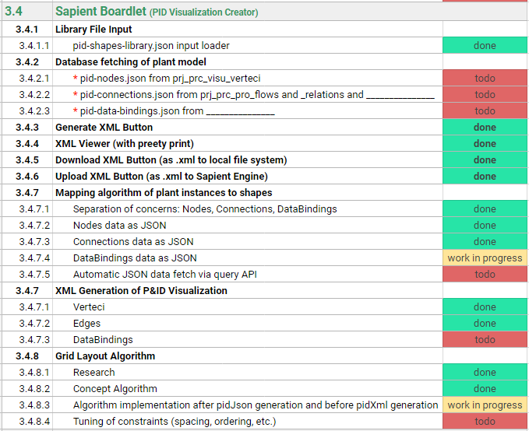
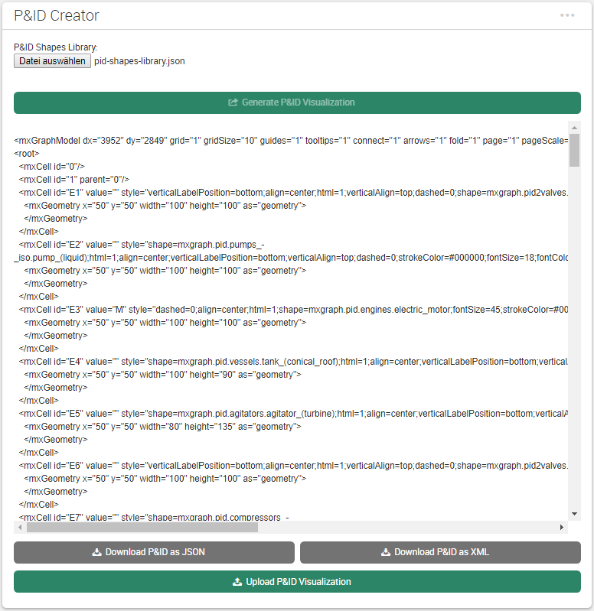
Sapient Boardlet Weekly Sprint 9
1
1
2
In client- background
3
2
3
4
5
In client- background
4
4
5

Slide 9
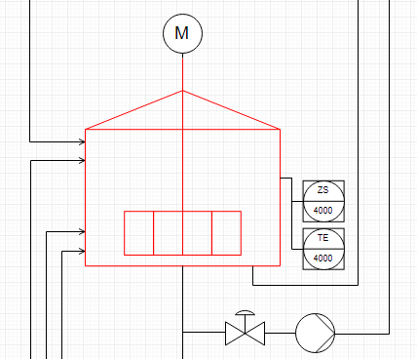
3.4.8 – Vertex Layout Algorithm Concept
Instance Hierarchy Traversal
Instance Hierarchy in model via parent attribute.
Once cModule layer reached, work with place all inside parent.
When done, move to parent’s next children.
Repeat.
Enterprise : AIDA Cruises
1
Site : AIDA
2
Area : Brewery
3
Process Cell : Brewhouse
4
Unit : U_L2
5
U_M5
1
U_P3
5
U_W3
1
EModule : Water_injection
6
Stem_ heating
11
16
…
…
…
…
…
…
…
…
…
…
…
…
…
CModule :
6
7
8
9
10
12
13
14
15
…
…
…
…
…
…
…
Control_valve_440
Pump_P40
Motor
Kettle_sensor_Z
Kettle_sensor_T

Slide 10
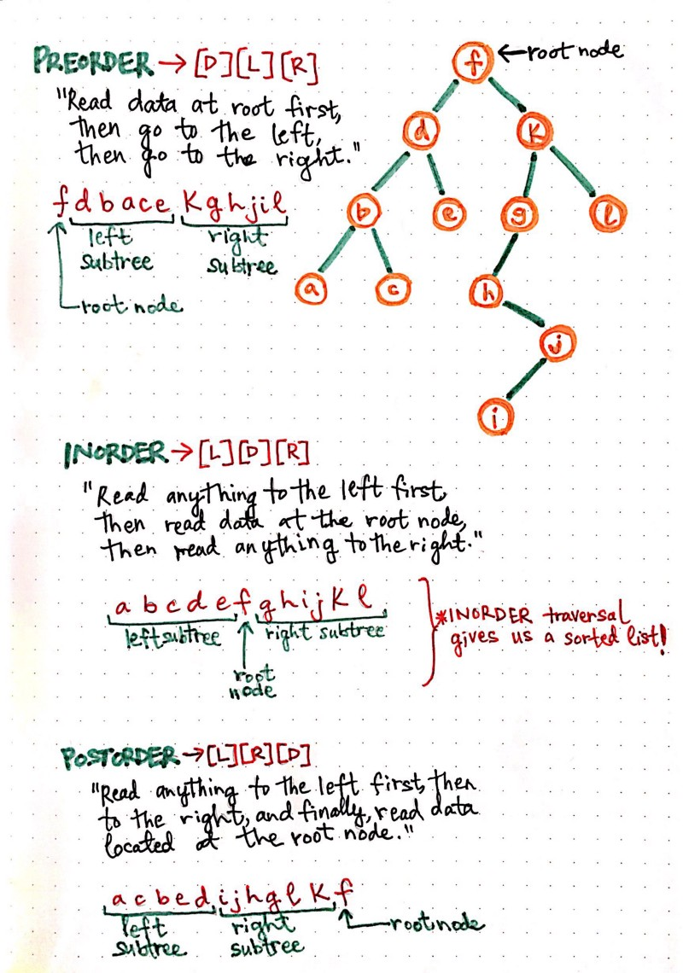
3.4.8 – Vertex Layout Algorithm Concept
Tree (hierarchy) traversal methods
Preorder [D][L][R]
Inorder [L][D][R]
Postorder [L][R][D]
Vertex placement, then next vertex placement, then next vertex placement, … , finally group placment
https://medium.com/basecs/demystifying-depth-first-search-a7c14cccf056

Slide 11
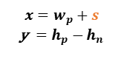
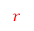
3.4.8 – Vertex Layout Algorithm Concept
Vertex Placement
Depth-first traversal of instance hierarchy (IH) via parent attribute until cModule.
Vertex placement inside group: relative positioning with constraints
Rules for example: if (valve to instrument) : instrument above valve
Implement units and cModules as groups (containers) with mxGraph API.
Count units to construct general grid layout.
Geometry between neighbouring children
$$x=w_{p}+s$$
y$=h_{p}−$ $h_{n}$
wn/2
wp/2
(x, y)
hn/2
hp/2
(0, 0)
spacing
Hgmax (currently)
$$r$$
Wgmax (currently)
Relative Positioning
vertex placement group placement group placement … (recursively)
Parent vertex
(0, 0)
(-0.5,0.5)
(0.5, 0.5)
(1, 1)

Slide 12
Issues and challenges Weekly Sprint 9
Default sizes not to scale → Size modifications to be made (defaults left for now)
Layout algorithm: clarity and structure over efficiency → Optimization not that important
Instance hierarchy (parent-child relationships defined in l_nodes) will serve for inclusion graphing algorithm to group
shapeName defines line type, but line type is implemented as a stereotype, or under which table?
Use node_level (0-4: site, area, cell, unit, emodule) for groups or set shapeName also for these instances in l_nodes (for example: shapeName = site_group)
Instrumet is CModule. But is its node_level the same as his parent’s (for example tank), or one less?

Slide 13
Dynamic Generation of Modular Industrial Plant Visualizations
Weekly Meeting 10
Miguel Romero Karam

Slide 14
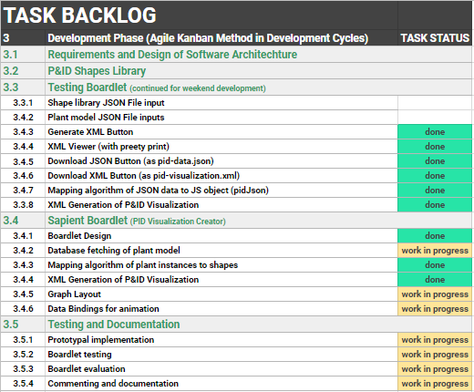
Task Backlog – Overview Overview of tasks: Week 10

Slide 15
Task Backlog – Overview Overview of tasks: Week 10

Slide 16
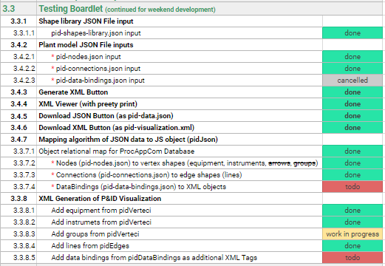
Testing Boardlet Weekly Sprint 10
In client- background

Slide 17
Task Backlog – Overview Overview of tasks: Week 10

Slide 18
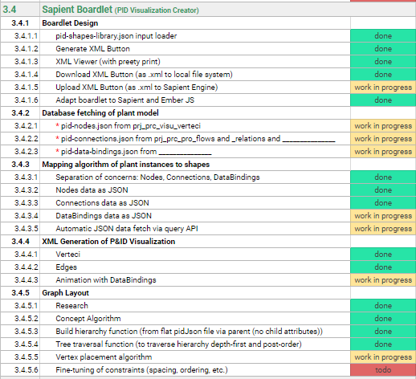
Sapient Boardlet Weekly Sprint 10
UPDATE

Slide 19
3.4.8 – Vertex Layout Algorithm Concept
Instance Hierarchy Traversal
Instance Hierarchy in model via parent attribute.
Once cModule layer reached, work with place all inside parent.
When done, move to parent’s next children.
Repeat.
Enterprise : AIDA Cruises
1
Site : AIDA
2
Area : Brewery
3
Brewhouse : Process Cell
4
Unit : U_L2
5
U_M5
1
U_P3
5
U_W3
1
EModule : Water_injection
6
Stem_ heating
11
16
…
…
…
…
…
…
…
…
…
…
…
…
…
CModule :
6
7
8
9
10
12
13
14
15
…
…
…
…
…
…
…
Control_valve_440
Pump_P40
Motor
Kettle_sensor_Z
Kettle_sensor_T

Slide 20
3.4.8 – Vertex Layout Algorithm Concept
Vertex Placement
Depth-first traversal of instance hierarchy (IH) via parent attribute until cModule.
Vertex placement inside group: relative positioning with constraints
Rules for example: if (valve to instrument) : instrument above valve
Implement units and cModules as groups (containers) with mxGraph API.
Count units to construct general grid layout.
Geometry between neighbouring children
$$x=w_{p}+s$$
y$=h_{p}−$ $h_{n}$
wn/2
wp/2
(x, y)
hn/2
hp/2
(0, 0)
spacing
Hgmax (currently)
$$r$$
Wgmax (currently)
Relative Positioning
vertex placement group placement group placement … (recursively)
Parent vertex
(0, 0)
(-0.5,0.5)
(0.5, 0.5)
(1, 1)

Slide 21
Issues and challenges Weekly Sprint 10
Connection to Database
Problem: Tables not in repository
Solution: Added tables to Repository via LC2

Slide 22
Next Sprint – ToDos Weekly Sprint 10
Boardlet Design
Fix floating buttons (side-by-side)
Root node selection also for multiple (with parameters.nodeList)
Design of root-node-selection input field
Build Hierarchy Function
Fix to start from selected root node (to work out for multiple)
Database queries
Connect remaining tables to repository with LC2 (instructions in daily-routine notes)
getData() generic Function
pidRootNode name query (to display in input field on updateInput())
pidNodes parameter definition
pidConnections parameter definition
Process Variables parameter definition
Animations via sapient-bind
Documentation and Commenting
Modularization of code
JsDocs
Testing

Slide 23
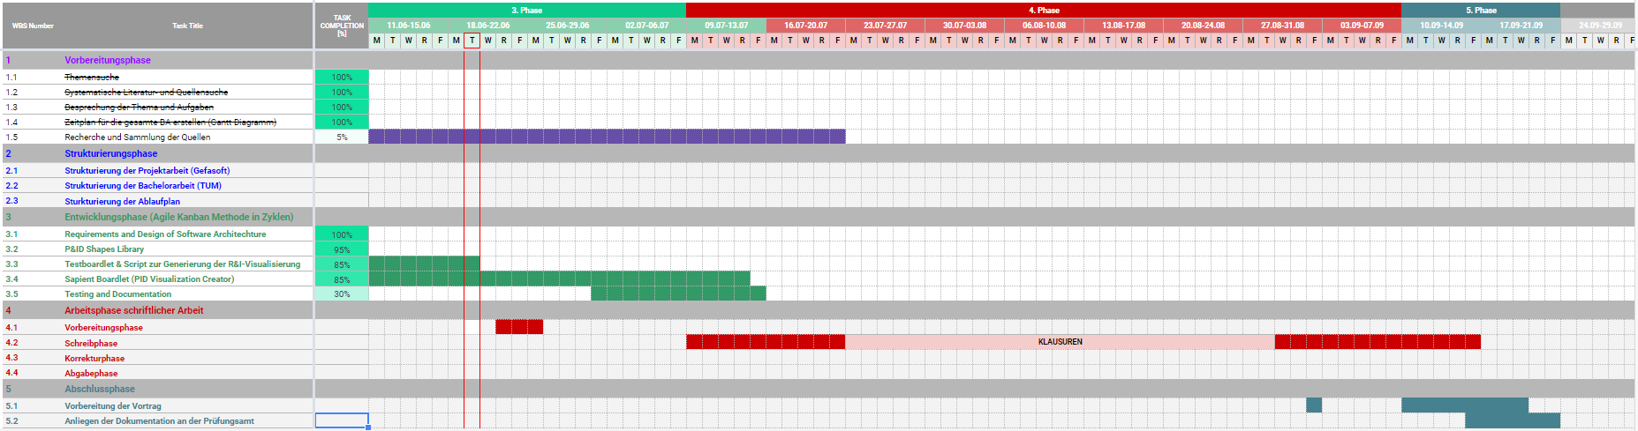
Project – Overview Overview of tasks: Week 10

Slide 24
Dynamic Generation of Modular Industrial Plant Visualizations
Weekly Meeting 11
Miguel Romero Karam

Slide 25
Task Backlog – Overview Overview of tasks: Week 11

Slide 26
Task Backlog – Overview Overview of tasks: Week 10

Slide 27
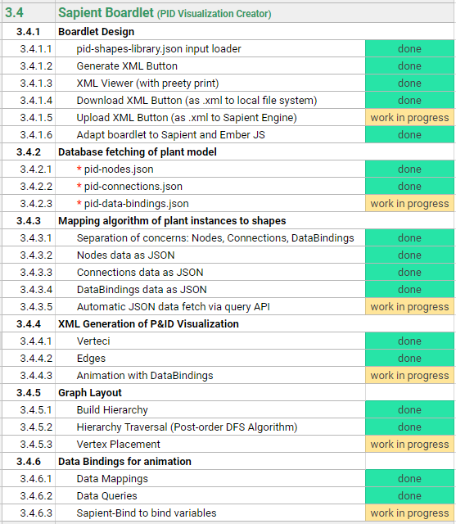
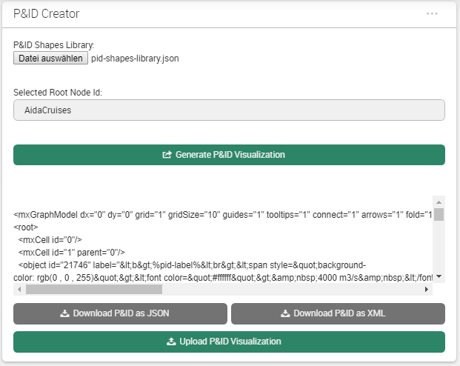
Sapient Boardlet Weekly Sprint 10

Slide 28
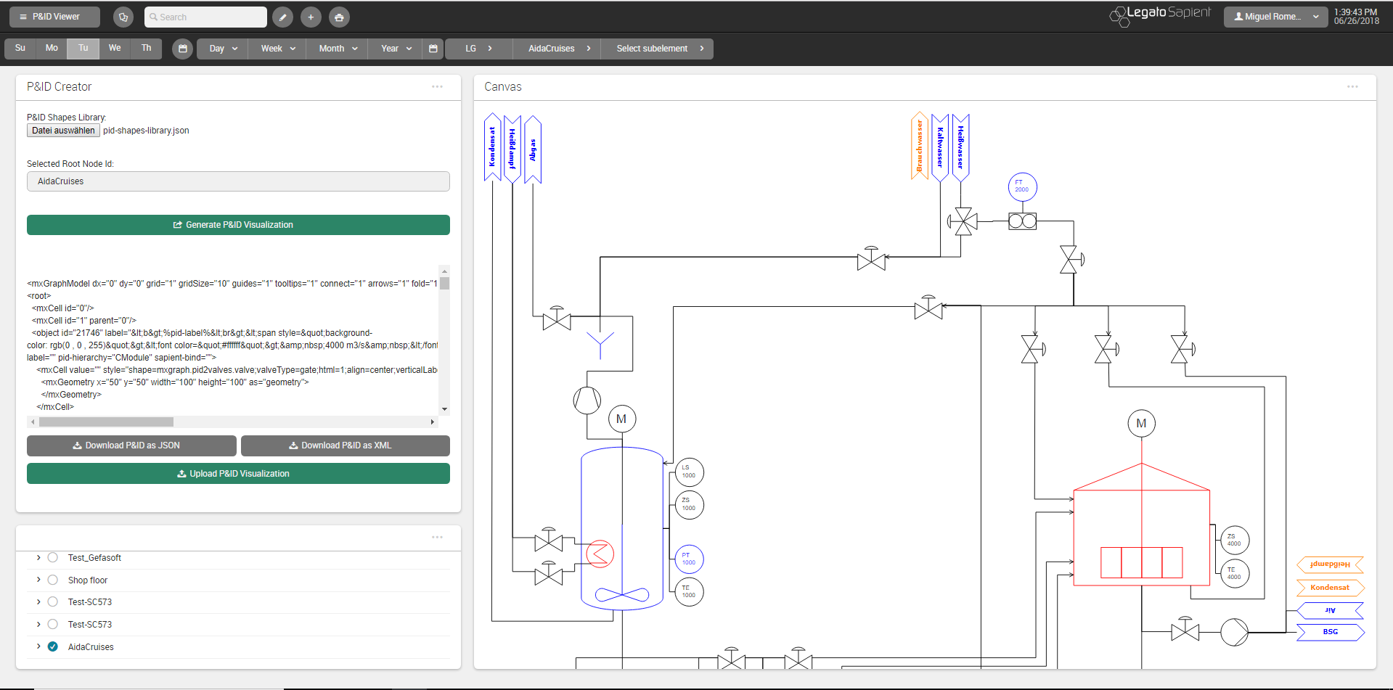
P&ID Viewer - Dashboard

Slide 29
Database Queries Overview: Data Map
l_nodes
prj_prc_pro_flows
p_values_current
id [PK] : Int
id [PK] : Int
id [PK] : Int
node_level : Int
node0 : Int
value_bool : Int
node_type : Int
node1 : Int
copies
value_num : Double
parent : Int
port0 : Int
value_str : String
short_name : String
port1 : Int
p_values_config
value_date : Timestamp
name_0 : String
product : Int
time_stamp : Timestamp
name_1 : String
is_continuous : Boolean
id [PK] : Int
last_archive_id : Int
description_0 : String
rate_value : Int
connection : Int
last_update : Timestamp
description_1 : String
flow_type : String
value_type : Int
…
permissions : Int
value_format : Int
attr_jsonb : Jsonb
value_symbol: String
p_value_types
modelId : Int
prj_prc_visu_vertices
name_0: String
isaLevel : String
id [PK] : Int
name_1: String
id [PK] : Int
valPrefix : String
node : Int
…
name_0 : String
standingData: Array
shape_name : String
name_1 : String
opcUALevel : Int
is_instrument : Boolean
description_0 : String
opcUANamespaceName : String
pid_label : String
description_1 : String
opcUAAddressPrefix : String
pid_function : String
…
…
pid_number : String

Slide 30
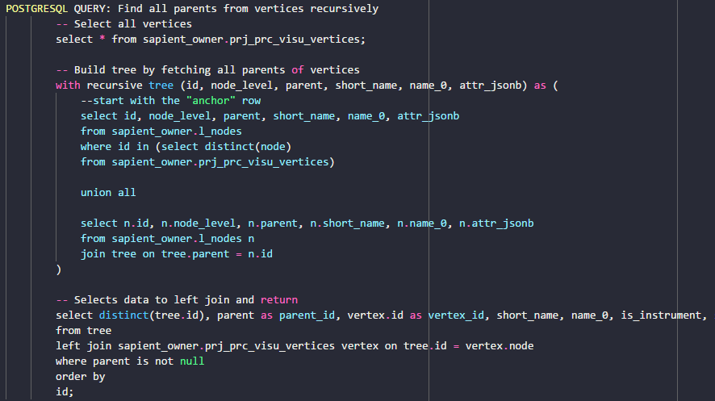
Database Queries Nodes Query - Problem
SQL- Query:
Complex SQL Query with LEFT JOIN not possible with getRecords options
Workaround with javascript:
2 distinct queries
Left Join Function in javascript on common attribute.
prj_prc_visu_vertices
l_nodes
id [PK] : Int
id [PK] : Int
node : Int
node_level : Int
shape_name : String
node_type : Int
is_instrument : Boolean
parent : Int
pid_label : String
short_name : String
pid_function : String
name_0 : String
pid_number : String
name_1 : String
description_0 : String
l_nodes
description_1 : String
Wanted Query Data
permissions : Int
attr_jsonb : Jsonb
visu_vertices
modelId : Int
isaLevel : String
valPrefix : String
standingData: Array
opcUALevel : Int
opcUANamespaceName : String
opcUAAddressPrefix : String
…
LEFT JOIN
ON tree.id = vertex.node

Slide 31
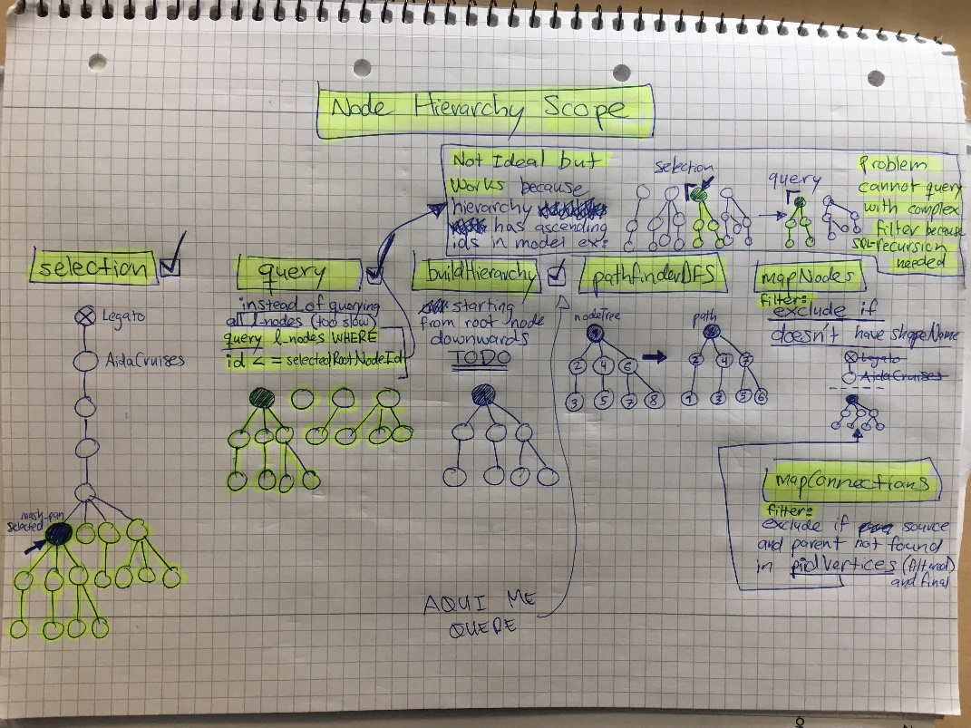
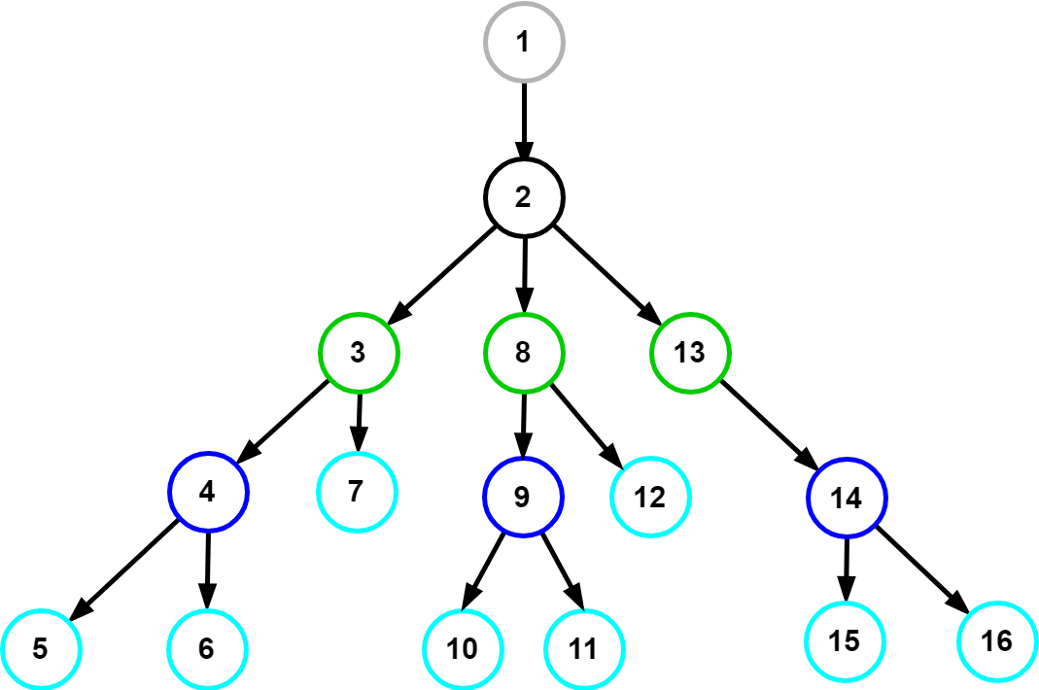
Database Queries Nodes Query - Solution
Query all after selection and filter afterwards in buildHierarchy function.
Selection
DB-Query
buildHierarchy
>= rootId
selected root
If ‘Legato’ root node selected, ask for another selection. If not, record rootId
Query all after selected root node id:
SELECT * FROM l_nodes
LEFT JOIN prj_prc_visu_vertices
ON node = parent
WHERE l_nodes.id >= rootId;
Starting from root node
Filter out non descendants of selected root node
Extract children of descendants via parent attributes.
Build hierarchy for root node and descendants.

Slide 32
Database Queries Nodes Query - Solution
Query all after selection and filter afterwards in buildHierarchy function.
Selection
DB-Query
buildHierarchy
>= rootId
selected root
If ‘Legato’ root node selected, ask for another selection. If not, record rootId
Query all after selected root node id:
SELECT * FROM l_nodes
LEFT JOIN prj_prc_visu_vertices
ON node = parent
WHERE l_nodes.id >= rootId;
Starting from root node
Filter out non descendants of selected root node
Extract children of descendants via parent attributes.
Build hierarchy for root node and descendants.

Slide 33
Database Queries Connections Query
Complex SQL Query with LEFT JOIN
Workaround with javascript:
2 distinct queries
Left Join Function in javascript on common attribute
p_values_current
id [PK] : Int
value_bool : Int
value_num : Double
value_str : String
l_nodes
prj_prc_pro_flows
p_values_config
value_date : Timestamp
Wanted Query Data
id [PK] : Int
time_stamp : Timestamp
id [PK] : Int
last_archive_id : Int
visu_vertices
node0 : Int
connection : Int
node1 : Int
last_update : Timestamp
port0 : Int
value_type : Int
…
port1 : Int
value_format : Int
product : Int
value_symbol: String
p_value_types
is_continuous : Boolean
name_0: String
id [PK] : Int
rate_value : Int
name_1: String
name_0 : String
flow_type : String
…
name_1 : String
description_0 : String
LEFT JOIN
ON tree.id = vertex.node
description_1 : String
…

Slide 34
Nodes buildHierarchy()
flatArray
treeArray
buildHierarchy(flatArray)
Input
Output
Flat Array (hierarchical relations via parent attribute):
Tree Array (nested hierarchy via children attribute):
1 | 2 | 3 | 4 | 5 | 6 | 7 | 8 | 9 | 10 | 11 | 12 | 13 | 14 | 15 | 16
1 | 2 | 3 | 4 | 5 | 6 | 7 | 8 | 9 | 10 | 11 | 12 | 13 | 14 | 15 | 16

Slide 35
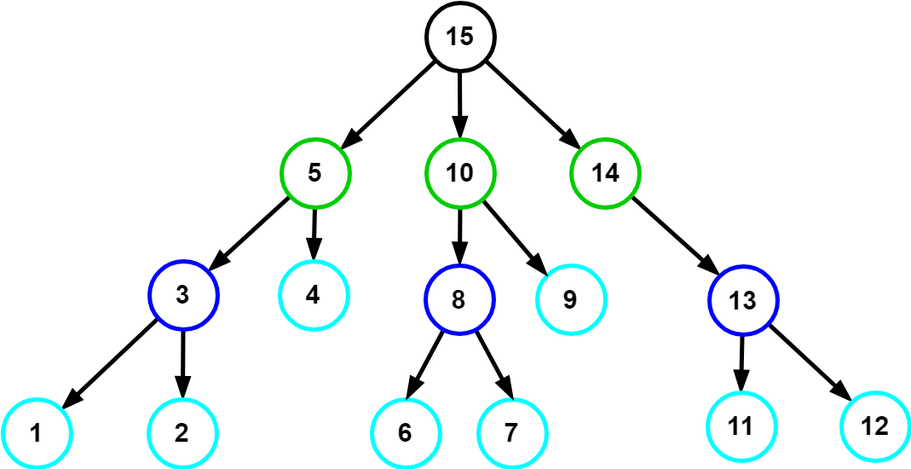
Nodes traverseAndSort()
nodeTree
path
(for vertex placement)
traverseAndSort(nodeTree)
Input
Output
Tree Array (nested hierarchy):
Path Array:
1 | 2 | 3 | 4 | 5 | 6 | 7 | 8 | 9 | 10 | 11 | 12 | 13 | 14 | 15 | 16
1 | 2 | 3 | 4 | 5 | 6 | 7 | 8 | 9 | 10 | 11 | 12 | 13 | 14 | 15 | 16

Slide 36
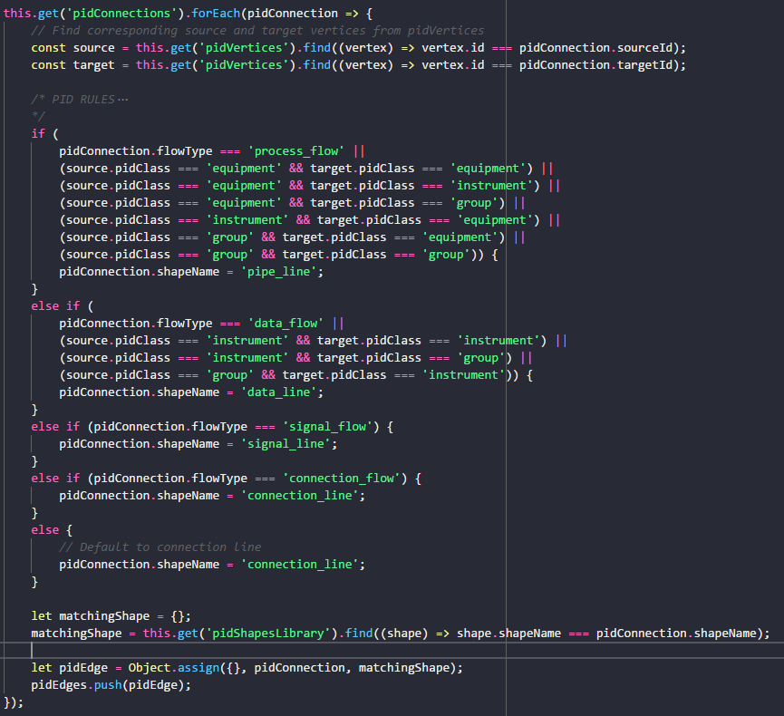
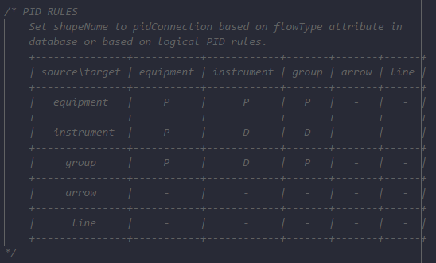
Connections mapConnectionsToShapes()
P&ID Rules to determine shapeName according to pidClass of source and target shapes of connection.
Rules as Adjacency Matrix:

Slide 37
vertexPlacement() Concept
DFS Pathfinder traversal returns traversal path (ordered array of vertices)
Count units to construct general grid layout.
Implement Units and CModules as groups (containers) with mxGraph API.
Vertex placement inside group: square grid algorithm places nodes inside
Rules for example: if (valve to instrument) : instrument above valve
pidLevel to isaLevel map:
1 : Enterprise
2 : Site
3 : Area
4 : Process Cell
5 : Unit
6 : Emodule
…
n : Cmodule
(only last level labelled as Cmodule)
Enterprise : AIDA Cruises
…
Site : AIDA
…
Area : Brewery
…
Process Cell : Brewhouse
…
REMAKE WITH DRAW IO
Constructs grid layout as 2D-array
Units layed out inside each grid cell separately, units placed in grid at the end.
Unit : U_L2
13
U_M5
17
U_P3
…
…
EModule : Water_injection
6
Stem_ heating
12
14
15
16
…
…
…
…
…
…
…
…
…
…
…
Siblings (in level)
CModule :
1
2
3
4
5
7
8
9
10
…
…
…
…
…
…
Control_valve_440
Pump_P40
Motor
Kettle_sensor_Z
Kettle_sensor_T
11

Slide 38
vertexPlacement() 3 – placeVertices()
nodeTree
path
(for vertex placement)
placeVertices(path)
Input
Output
Tree Array (nested hierarchy):
Path Array:
1 | 2 | 3 | 4 | 5 | 6 | 7 | 8 | 9 | 10 | 11 | 12 | 13 | 14 | 15 | 16
1 | 2 | 3 | 4 | 5 | 6 | 7 | 8 | 9 | 10 | 11 | 12 | 13 | 14 | 15 | 16

Slide 39
vertexPlacement() Family Tree Analogy - Terminology
Path Array:
1 | 2 | 3 | 4 | 5 | 6 | 7 | 8 | 9 | …
Areas Array:
1 | 2
3 | 4
4
1 | 2 | 3 | 4 | 5
1 | 2 | 3 | 4 | 5
1 | 2 | 3 | 4 | 5
1 | 2 | 3 | 4 | 5
1 | 2 | 3 | 4 | 5
1 | 2 | 3 | 4 | 5
1 | 2 | 3 | 4 | 5
1 | 2 | 3 | 4 | 5
1 | 2 | 3 | 4 | 5

Slide 40
Vertex Placement Constraints
Constraints: provided as additional inputs to graphing algorithm
Knowledge about graph semantics required for example:
place a given vertex in the “middle” of the drawing
place a given vertex on the external boundary of the drawing
draw a subgraph with a prescribed “shape”
keep a group of vertices “close” together
1. Algorithmic Approach → For minimizing area
Graph layout generated according to a prescribed set of aesthetic criteria.
Aesthetic criteria in algorithm as optimizatioin goals (minimize crossings, minimize area …)
Advantages: computational efficiency
Disadvantages: user-defined constraints not naturally supported.
2. Declarative Approach → For vertex positioning
Graph layout specified by user-defined set of constraints.
Layout generated by the solution of a system of constraints.
Advantages: expressive power
Disadvantages: some natural aesthetics (e.g. planarity) need complex constraints, general constraint solving systems are computationally inneficient (think of many if-thens), lack of powerful language for constraint specification.
http://cs.brown.edu/people/rtamassi/papers/gd-tutorial/gd-constraints.pdf

Slide 41
Vertex Positioning Rules
Positioning Rules based on shapeCategory: (inline/block/center/nucleus tags. tiles system, declarative
current previous | agitators | arrows | compressors | heat exchangers | engines | flow sensors | filters | pumps | valve | group | instrument | vessel
agitators | - | - | - | - | 1 | - | - | - | - | 2 | - | 3
arrows | - | - | - | - | - | - | - | - | - | - | - | -
compressors | - | - | - | - | - | -
heat exchangers
engines
flow sensors
filters
pumps
valve
group
instrument
vessel

Slide 42
vertexPlacement() Algorithm Overview
forEach vertex in pidVertices:
if (not group):
calculate cell area
store cell area
position current vertex:
get previous vertex position (x, y values)
apply positioning rules
set current vertex position
update value of previous x, y values
else if (group):
sum areas of contained cells

Slide 43
Data Bindings Overview
User objects and metadata:
The User object is what gives mxGraph diagrams a context, it stores the business logic associated with a visual cell.
Can be simply a string or value and even an object.
mxGraph supports the process of populating the model on the server-side and transmitting to the client, and back again. See the later chapter on “I/O and Server Communication”.
The data transmitted will be both the visual model (the diagram) as well as the business logic (mostly contained in the user objects).
PID metadata of the cell (non mxGraph data) can be included here as key-value pairs.
Values are then accessible through the key via placeholders.
value:
Removed value attribute from mxCell (default is null) because it would override the binded object surrounding the mxCell.
When value attribute is omitted in mxCell, the object surrounding the mxCell is enabled.
placeholders:
Placeholders can be used in labels and tooltips to reference properties of cells or ancestors, including the properties of the diagram.
Must be enabled for all objects: set ‘placeholders’ attribute to ‘1’ or check the Placeholders option in the metadata dialog.
To reference a property in a label or tooltip, place the name of the property between % signs.
placeholder:
A special field called in the metadata of the cell that can be used to reference the value under the given name in the cell's or an ancestor's metadata.

Slide 44
Next Sprint – ToDos Weekly Sprint 10
Boardlet Design
Fix floating buttons (side-by-side)
Design of root-node-selection input field
Fix query of siblings when selecting one root node
Build Hierarchy Function
Fix to start from selected root node (to work out for multiple)
Database queries
Connect remaining tables to repository with LC2 (instructions in daily-routine notes)
getData() generic Function
pidRootNode name query (to display in input field on updateInput())
pidNodes query
pidConnections query
Process Variables query
Animations via sapient-bind
Documentation and Commenting
Modularization of code
JsDocs
Testing

Slide 45

Project – Overview Overview of tasks: Week 10

Slide 46
Dynamic Generation of Modular Industrial Plant Visualizations
Weekly Meeting 13
Miguel Romero Karam

Slide 47
Task Backlog – Overview Overview of tasks: Week 11

Slide 48
Task Backlog – Overview Overview of tasks: Week 10

Slide 49
Sapient Boardlet Weekly Sprint 10

Slide 50
P&ID Viewer - Dashboard

Slide 51
Database Queries Overview: Data Map
l_nodes
prj_prc_pro_flows
p_values_current
id [PK] : Int
id [PK] : Int
id [PK] : Int
node_level : Int
node0 : Int
value_bool : Int
node_type : Int
node1 : Int
value_num : Double
parent : Int
port0 : Int
value_str : String
short_name : String
port1 : Int
p_values_config
value_date : Timestamp
name_0 : String
product : Int
time_stamp : Timestamp
name_1 : String
is_continuous : Boolean
id [PK] : Int
last_archive_id : Int
description_0 : String
rate_value : Int
connection : Int
last_update : Timestamp
description_1 : String
flow_type : String
value_type : Int
…
permissions : Int
value_format : Int
attr_jsonb : Jsonb
value_symbol: String
p_value_types
modelId : Int
prj_prc_visu_vertices
name_0: String
isaLevel : String
id [PK] : Int
name_1: String
id [PK] : Int
valPrefix : String
node : Int
…
name_0 : String
standingData: Array
shape_name : String
name_1 : String
opcUALevel : Int
is_instrument : Boolean
description_0 : String
opcUANamespaceName : String
pid_label : String
description_1 : String
opcUAAddressPrefix : String
pid_function : String
…
…
pid_number : String

Slide 52
Database Queries Nodes Query - Problem
SQL- Query:
Complex SQL Query with LEFT JOIN not possible with getRecords options
Workaround with javascript:
2 distinct queries
Left Join Function in javascript on common attribute.
prj_prc_visu_vertices
l_nodes
id [PK] : Int
id [PK] : Int
node : Int
node_level : Int
shape_name : String
node_type : Int
is_instrument : Boolean
parent : Int
pid_label : String
short_name : String
pid_function : String
name_0 : String
pid_number : String
name_1 : String
description_0 : String
l_nodes
description_1 : String
Wanted Query Data
permissions : Int
attr_jsonb : Jsonb
visu_vertices
modelId : Int
isaLevel : String
valPrefix : String
standingData: Array
opcUALevel : Int
opcUANamespaceName : String
opcUAAddressPrefix : String
…
LEFT JOIN
ON tree.id = vertex.node

Slide 53
Database Queries Nodes Query - Solution
Query all after selection and filter afterwards in buildHierarchy function.
Selection
DB-Query
buildHierarchy
selected root
If ‘Legato’ root node selected, ask for another selection. If not, record rootId
Query all instance hierarchy:
SELECT * FROM l_nodes
LEFT JOIN prj_prc_visu_vertices
ON node = parent
Starting from root node
Filter out non descendants of selected root node
Extract children of descendants via parent attributes.
Build hierarchy for root node and descendants.

Slide 54
Database Queries Nodes Query - Solution
Query all after selection and filter afterwards in buildHierarchy function.
Selection
DB-Query
getHierarchy()
selected root
If ‘Legato’ root node selected, ask for another selection. If not, record rootId
Query all instance hierarchy:
SELECT * FROM l_nodes
LEFT JOIN prj_prc_visu_vertices
ON node = parent
Starting from root node
Filter out non descendants of selected root node
Extract children of descendants via parent attributes.
Build hierarchy for root node and descendants.

Slide 55
Database Queries Connections Query
Standard SQL Query from a single DB Table (prj_prc_pro_flows)
p_values_current
id [PK] : Int
value_bool : Int
value_num : Double
value_str : String
prj_prc_pro_flows
p_values_config
value_date : Timestamp
id [PK] : Int
time_stamp : Timestamp
id [PK] : Int
last_archive_id : Int
node0 : Int
connection : Int
node1 : Int
last_update : Timestamp
port0 : Int
value_type : Int
…
port1 : Int
value_format : Int
product : Int
value_symbol: String
p_value_types
is_continuous : Boolean
name_0: String
id [PK] : Int
rate_value : Int
name_1: String
name_0 : String
flow_type : String
…
name_1 : String
description_0 : String
description_1 : String
…

Slide 56
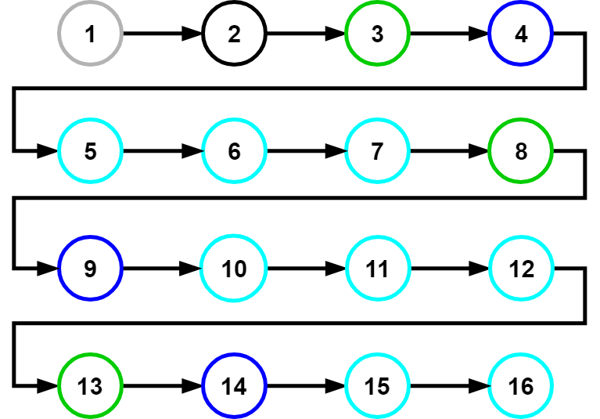
Nodes buildHierarchy()
flatArray
treeArray
buildHierarchy(flatArray)
Flat Array (hierarchical relations via parent attribute):
Tree Array (nested hierarchy via children attribute):
Input
1 | 2 | 3 | 4 | 5 | 6 | 7 | 8 | 9 | 10 | 11 | 12 | 13 | 14 | 15 | 16
Output
1 | 2 | 3 | 4 | 5 | 6 | 7 | 8 | 9 | 10 | 11 | 12 | 13 | 14 | 15 | 16

Slide 57
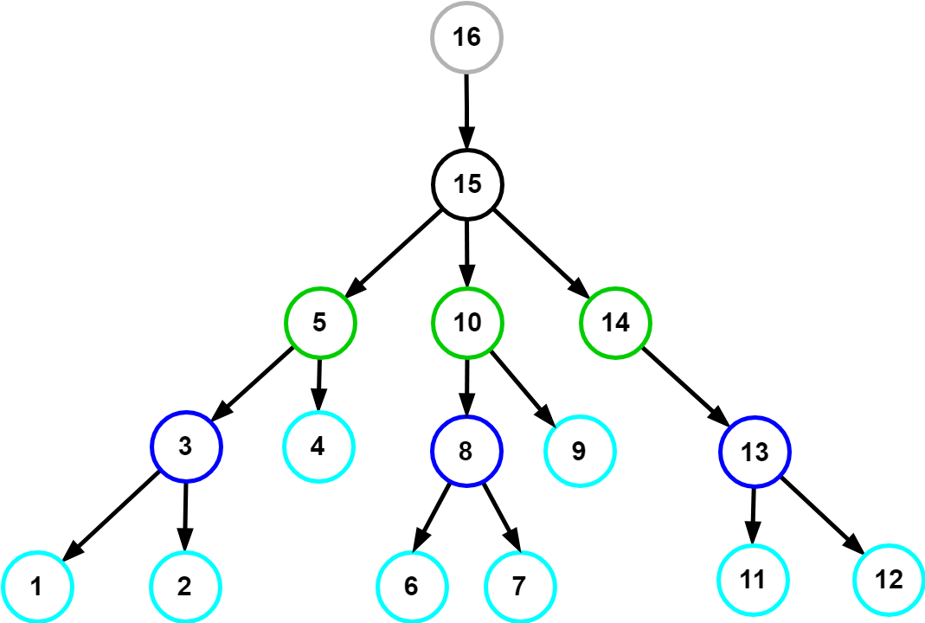
Nodes traverseAndSort()
nodeTree
path
traverseAndSort(nodeTree)
Tree Array (nested hierarchy):
Path Array:
Input
1 | 2 | 3 | 4 | 5 | 6 | 7 | 8 | 9 | 10 | 11 | 12 | 13 | 14 | 15 | 16
Output
1 | 2 | 3 | 4 | 5 | 6 | 7 | 8 | 9 | 10 | 11 | 12 | 13 | 14 | 15 | 16

Slide 58
Vertex Placement Constraints
Constraints: provided as additional inputs to graphing algorithm
Knowledge about graph semantics required for example:
place a given vertex in the “middle” of the drawing
place a given vertex on the external boundary of the drawing
draw a subgraph with a prescribed “shape”
keep a group of vertices “close” together
1. Algorithmic Approach → For minimizing area
Graph layout generated according to a prescribed set of aesthetic criteria.
Aesthetic criteria in algorithm as optimizatioin goals (minimize crossings, minimize area …)
Advantages: computational efficiency
Disadvantages: user-defined constraints not naturally supported.
2. Declarative Approach → For vertex positioning
Graph layout specified by user-defined set of constraints.
Layout generated by the solution of a system of constraints.
Advantages: expressive power
Disadvantages: some natural aesthetics (e.g. planarity) need complex constraints, general constraint solving systems are computationally inneficient (think of many if-thens), lack of powerful language for constraint specification.
http://cs.brown.edu/people/rtamassi/papers/gd-tutorial/gd-constraints.pdf

Slide 59
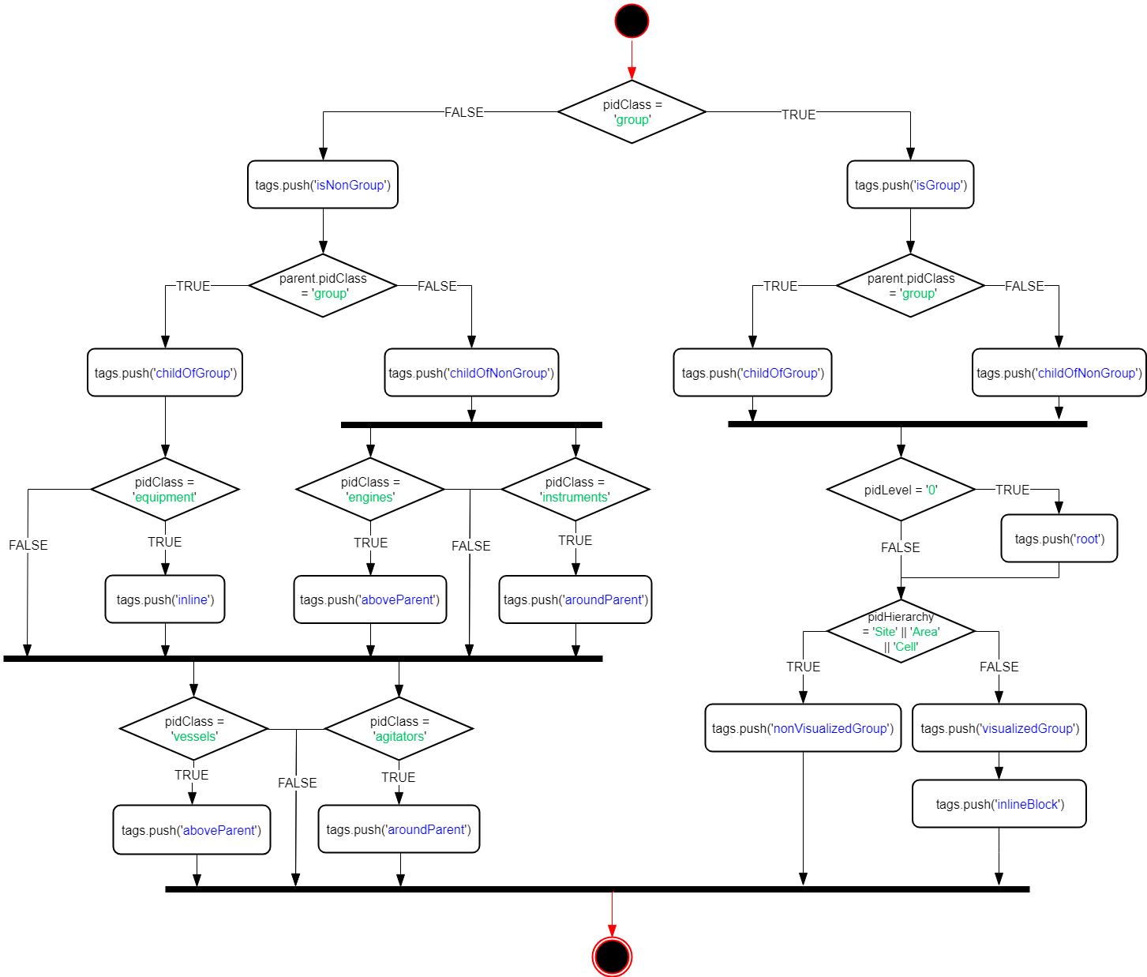
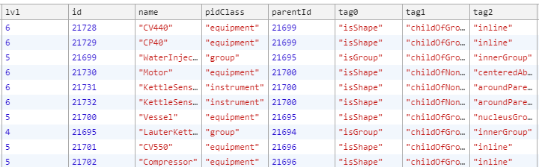
Vertex Positioning Rules
Positioning Rules based on shapeCategory:
Tags:

Slide 60
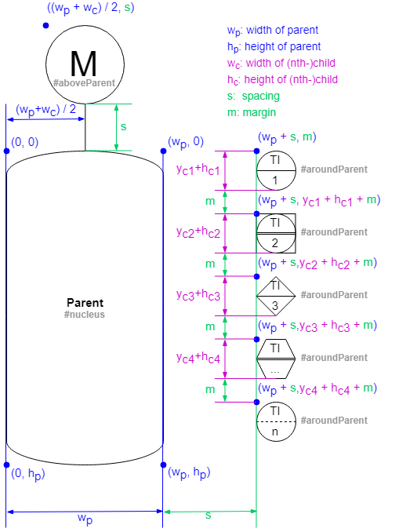
vertexPlacement() Example:

Slide 61
Data Bindings Overview
User objects and metadata:
The User object is what gives mxGraph diagrams a context, it stores the business logic associated with a visual cell.
Can be simply a string or value and even an object.
mxGraph supports the process of populating the model on the server-side and transmitting to the client, and back again. See the later chapter on “I/O and Server Communication”.
The data transmitted will be both the visual model (the diagram) as well as the business logic (mostly contained in the user objects).
PID metadata of the cell (non mxGraph data) can be included here as key-value pairs.
Values are then accessible through the key via placeholders.
value:
Removed value attribute from mxCell (default is null) because it would override the binded object surrounding the mxCell.
When value attribute is omitted in mxCell, the object surrounding the mxCell is enabled.
placeholders:
Placeholders can be used in labels and tooltips to reference properties of cells or ancestors, including the properties of the diagram.
Must be enabled for all objects: set ‘placeholders’ attribute to ‘1’ or check the Placeholders option in the metadata dialog.
To reference a property in a label or tooltip, place the name of the property between % signs.
placeholder:
A special field called in the metadata of the cell that can be used to reference the value under the given name in the cell's or an ancestor's metadata.

Slide 62
Previous Sprint – ToDos Weekly Sprint 10
Boardlet Design
Fix floating buttons (side-by-side)
Design of root-node-selection input field
Fix query of siblings when selecting one root node
Build Hierarchy Function
Fix to start from selected root node (to work out for multiple)
Database queries
Connect remaining tables to repository with LC2 (instructions in daily-routine notes)
getData() generic Function
pidRootNode name query (to display in input field on updateInput())
pidNodes query
pidConnections query
Process Variables query
Animations via sapient-bind
Documentation and Commenting
Modularization of code
JsDocs
Graphing Algorithm

Slide 63
Next Sprint – ToDos Weekly Sprint 10
Vertex placement algorithm
Continuous improvement
Animations via sapient-bind
Define sapient-bind JSON structure
Function to create data-bindings with data fechted from database
Upload button
Until now, no way of uploading files from client to the file system found (because of security issues)

Slide 64
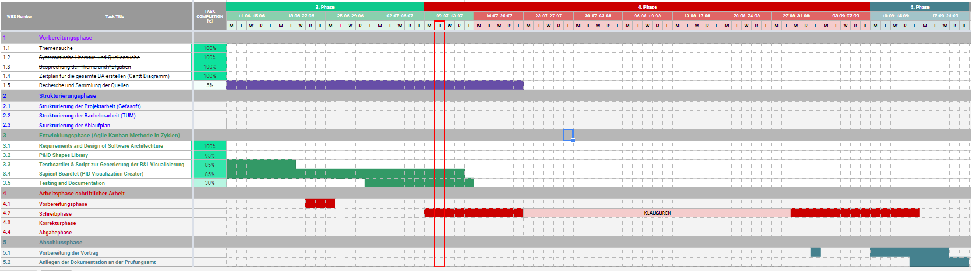
Project – Overview Overview of tasks: Week 10

Slide 65
vertexPlacement() Example:
forEach vertex in pidVertices:
if (not group):
calculate cell area
store cell area
position current vertex:
get previous vertex position (x, y values)
apply positioning rules
set current vertex position
update value of previous x, y values
else if (group):
sum areas of contained cells

Slide 66
Dynamic Generation of Modular Industrial Plant Visualizations
Weekly Meeting 14
Miguel Romero Karam

Slide 67
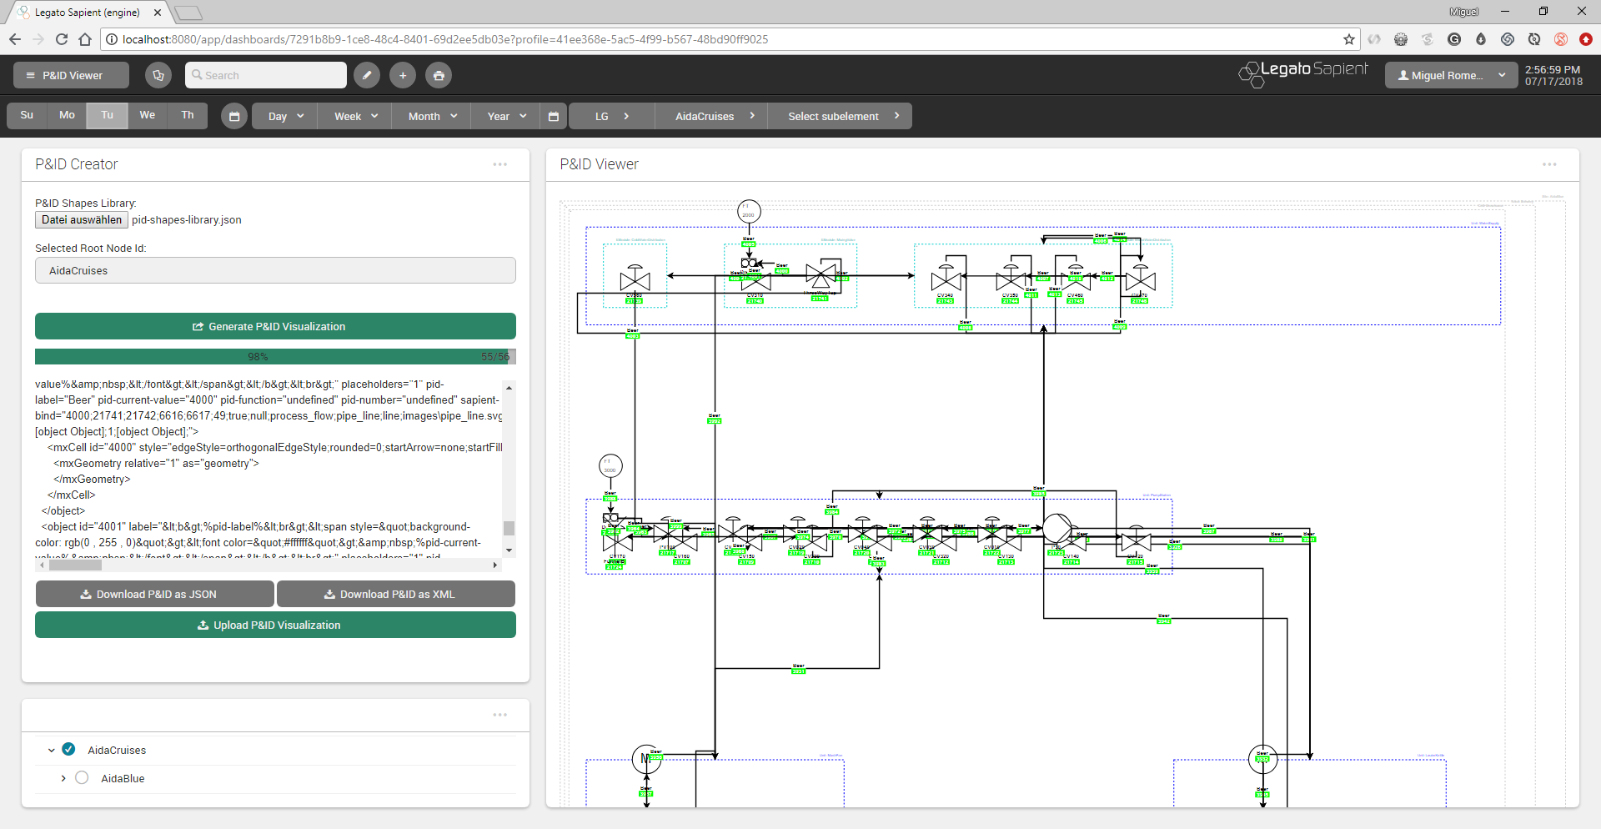
P&ID Viewer - Dashboard

Slide 68
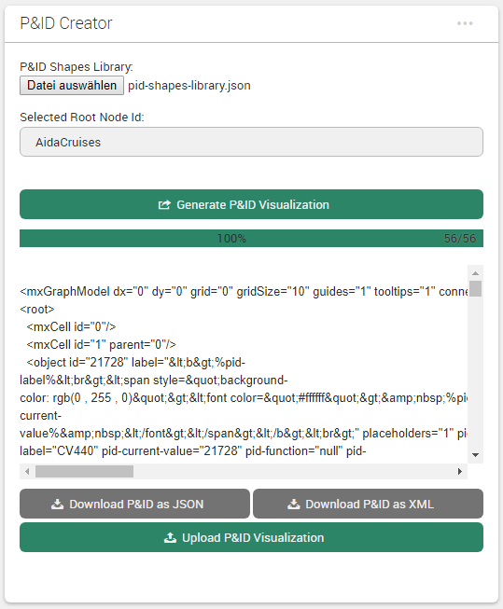
Sapient Boardlet Weekly Sprint 14

Slide 69
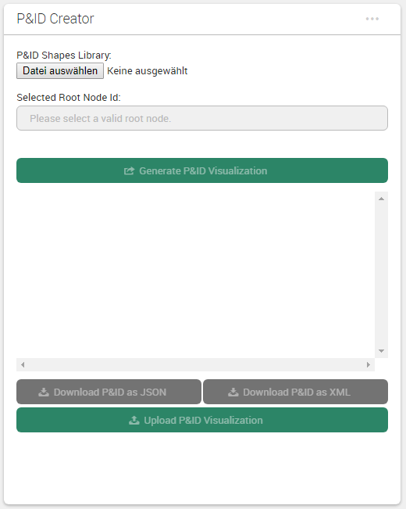
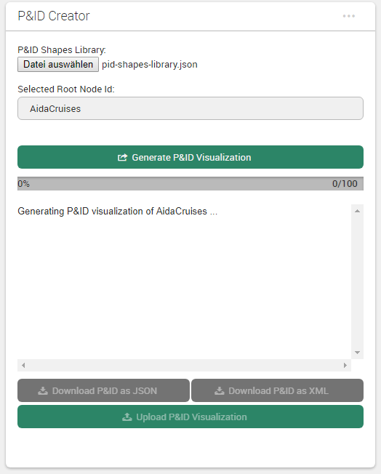
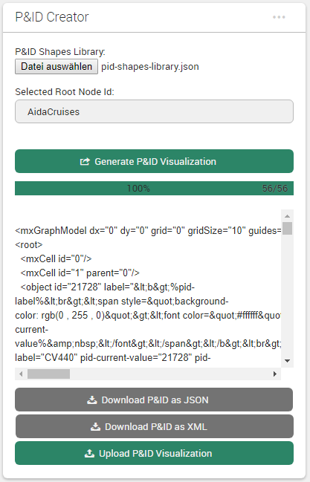
Boardlet Design Updates & Fixes
Implemented progress bar for vertex placement algorithm (can change to any function with iteration)
Fixed responsive layout of buttons when wrapped (narrow mobile screens)
1) on start
2) in progress
3) done
desktop
mobile

Slide 70
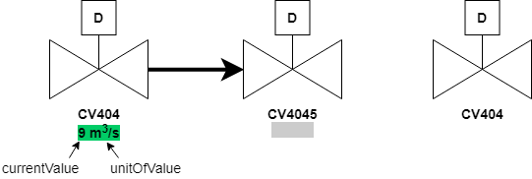
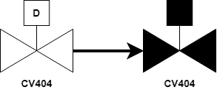
Data Bindings Overview
IDs of current values (primary key of p_values_current) stored in prj_prc_pro_flows under rate_value
Why are there only current values for flows ???
Only nodes with process variables have entry in p_values_current ???
Concept (getDataBindings):
Fetch IDs under rate_value along with query for pidConnections – done
For each ID: fetch and join p_values_config and p_values_current – done
Construct a sapientBind object for each rate_value depending on value type
ToDo:
Define data types: each data type (bool/int/float/string…) will have own sapientBind object for Example:
boolean (sets fillColor)
int (sets label) – concept because currently only bools
OR

Slide 71
Queries for Current Values Overview: Data Map
l_nodes
prj_prc_pro_flows
p_values_config
p_values_current
id [PK] : Int
id [PK] : Int
id [PK] : Int
copies
id [PK] : Int
node_level : Int
node0 : Int
connection : Int
value_bool : Int
node_type : Int
node1 : Int
value_type : Int
value_num : Double
parent : Int
port0 : Int
value_format : Int
value_str : String
short_name : String
port1 : Int
value_symbol: String
value_date : Timestamp
name_0 : String
product : Int
name_0: String
time_stamp : Timestamp
name_1 : String
is_continuous : Boolean
name_1: String
last_archive_id : Int
description_0 : String
rate_value : Int
…
last_update : Timestamp
description_1 : String
flow_type : String
…
permissions : Int
attr_jsonb : Jsonb
p_value_relations
modelId : Int
prj_prc_visu_vertices
p_value_types
isaLevel : String
id [PK] : Int
id [PK] : Int
id [PK] : Int
valPrefix : String
node : Int
node: Int
name_0 : String
standingData: Array
shape_name : String
value: Int
name_1 : String
opcUALevel : Int
is_instrument : Boolean
attr_jsonb : Jsonb
description_0 : String
opcUANamespaceName : String
pid_label : String
…
description_1 : String
opcUAAddressPrefix : String
pid_function : String
…
…
pid_number : String

Slide 72
Database Queries Nodes Query - Problem
SQL- Query:
Complex SQL Query with LEFT JOIN not possible with getRecords options
Workaround with javascript:
2 distinct queries
Left Join Function in javascript on common attribute.
prj_prc_visu_vertices
l_nodes
id [PK] : Int
id [PK] : Int
node : Int
node_level : Int
shape_name : String
node_type : Int
is_instrument : Boolean
parent : Int
pid_label : String
short_name : String
pid_function : String
name_0 : String
pid_number : String
name_1 : String
description_0 : String
l_nodes
description_1 : String
Wanted Query Data
permissions : Int
attr_jsonb : Jsonb
visu_vertices
modelId : Int
isaLevel : String
valPrefix : String
standingData: Array
opcUALevel : Int
opcUANamespaceName : String
opcUAAddressPrefix : String
…
LEFT JOIN
ON tree.id = vertex.node

Slide 73
Vertex Placement Algorithm Overview
Simplification of edges (clear connection waypoints between various edges if any)
Jump
Constraint specification in the form of tags
Positioning logic in the form of rules (depending on tags)
Setting of parameters
forEach vertex in pidVertices:
if (not group):
calculate cell area
store cell area
position current vertex:
get previous vertex position (x, y values)
apply positioning rules
set current vertex position
update value of previous x, y values
else if (group):
sum areas of contained cells

Slide 74
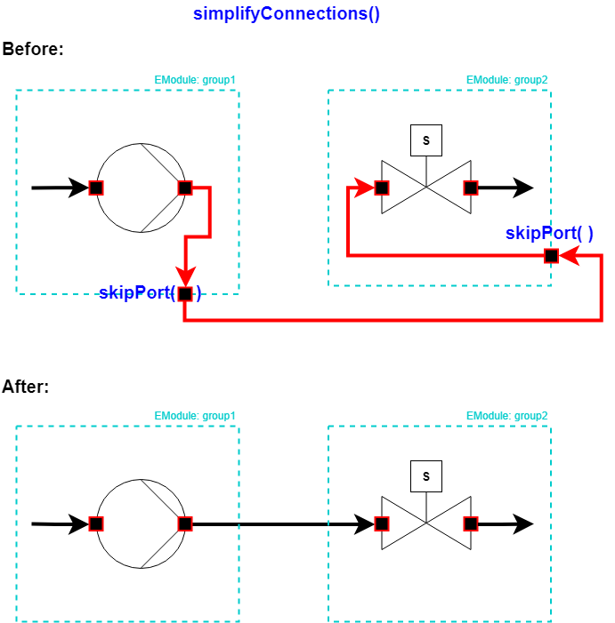
1. Simplification of Edges Overview
forEach edge in pidEdges:
if (already simplified):
skip
else if ()
calculate cell area
store cell area
position current vertex:
get previous vertex position (x, y values)
apply positioning rules
set current vertex position
update value of previous x, y values
else if (group):
sum areas of contained cells

Slide 75
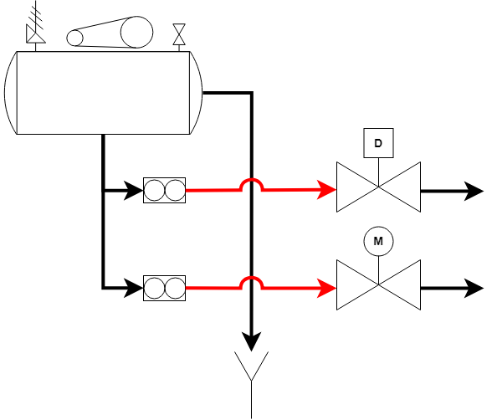
Line Jumps Example:
Problem:
Connections gehen vom Vertexmittelpunk zum Vertexmittelpunk
Connections werden automatisch optimiert um Kreuzungen zu vermindern aber unmöglich alle zu vermeiden
Dies führt zum Zusammenklappen verschiedene linen
Unübersichtlich
Lösung:
Line jumps
Arc form
radius 20pt

Slide 76
2. Constraint Specification Overview
Positioning Rules based on shape attributes:
Tags:
. . .

Slide 77
3. Vertex Placement Concept
Probleme:
Inkonsistenzen in das Model (Instance Hierarchy) wie z.B. Gruppen die Gruppen aber auch Shapes enthalten.
Führt zu Irreguläre Platzierung in die Mehrheit der Fälle → braucht zu viel Logik.
Relative positionierung deswegen manchmal suboptimal, aber trotzdem die beste Alternative
Viel Aufwand und wenig Fortschritt bei der Verbesserung des Algorithmus.
Lösungen (zum Teil):
Specification of Constraints erlaubt Logik gezielt zu programmieren
Constraints erlauben auch das progressive Enhancement
Block packing algorithm ist eine optimale Lösung für P&ID Diagramme falls alle children Gruppen sind (rechteckige Blocks). Nicht aber für shapes.

Slide 78
3.1 Placement Logic Example:
Kleine Modifikationen zum vorherigen Logik
Sonst gleich

Slide 79
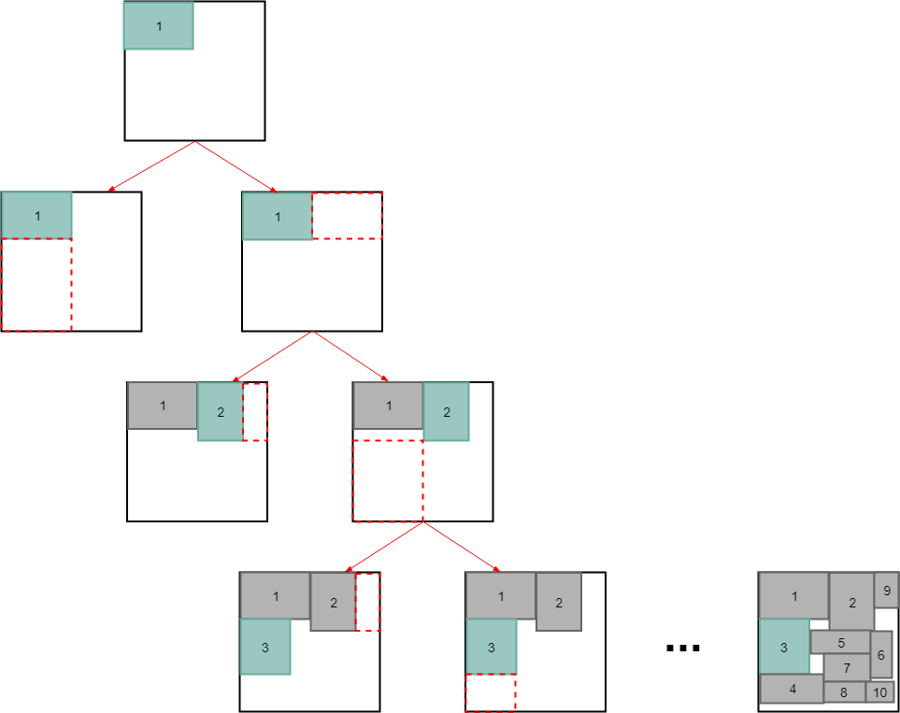
3.2 packBlocks() Overview
Binary tree block packing algorithm (for groups):
Sort blocks (clones) based on selected sortOrder option (none, width, height, area, maxSide)
Place first (root) block at (0, 0).
Place next block either right or bellow of previous (minimize area)
Repeat 3 until all blocks placed.
Update properties in original objects.
Sehr gute Ergebnisse für Blocks die nur Groupen sind (ohne Shapes)

Slide 80
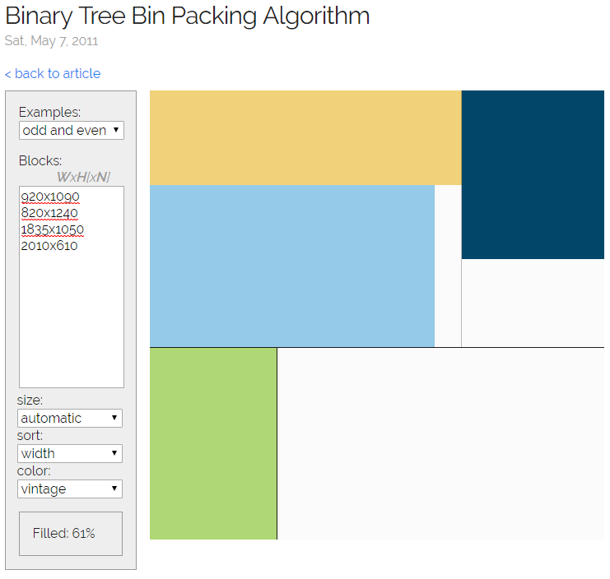
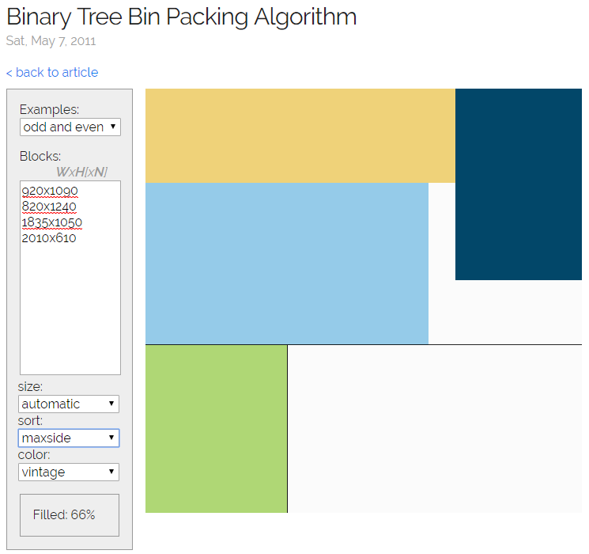
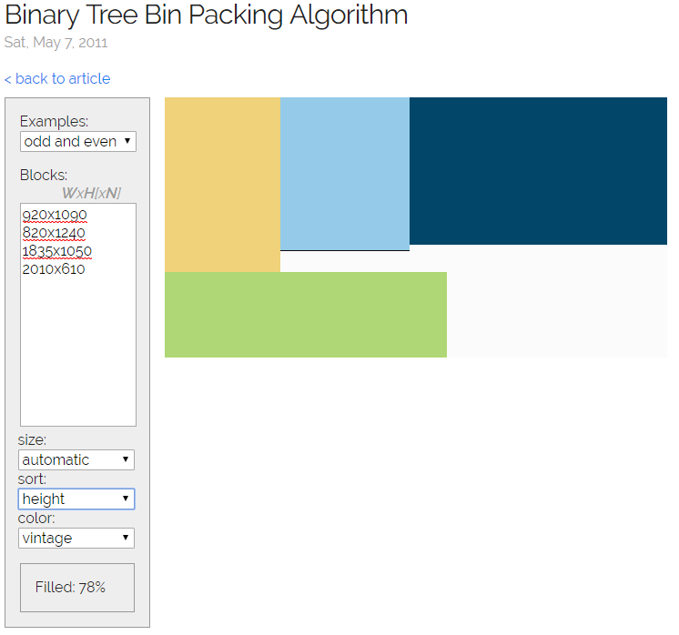
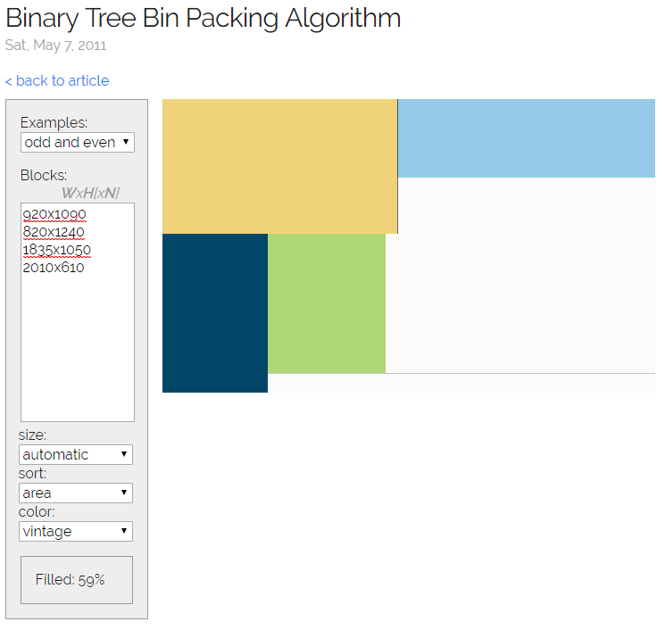
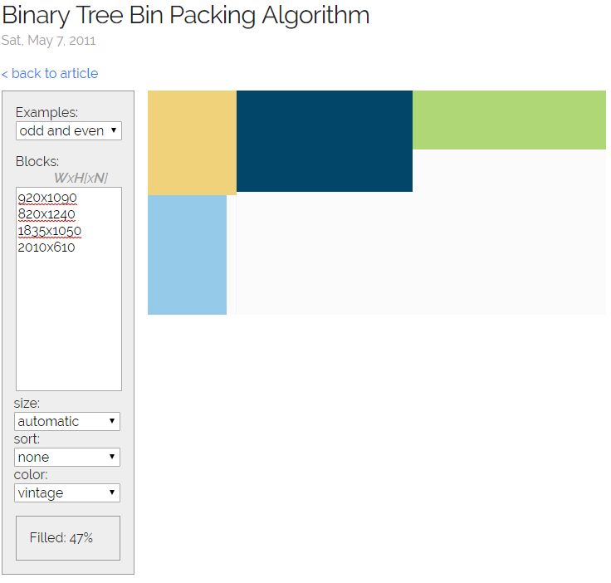
3.2 packBlocks() Sort Order Options
Beispiel mit 4 Units in Brewery (block dimensions to scale)
by height
none (default)
by area
by width
by maxSide

Slide 81
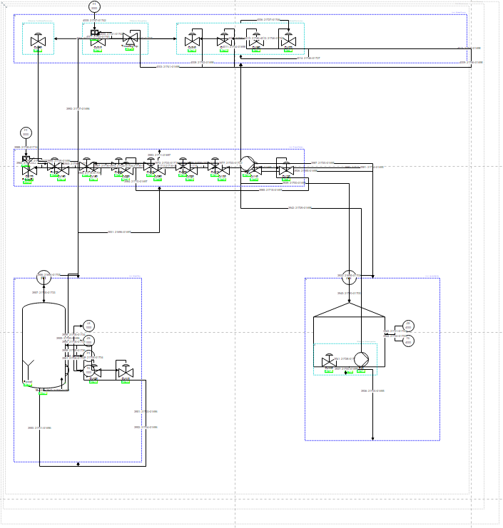
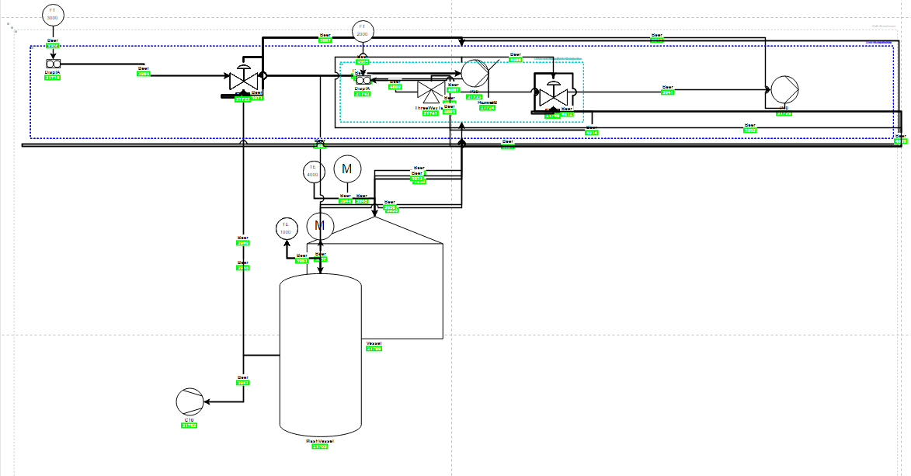
3.2 Bugs in Boardlet Algorithmus Sort Order Options
Obwohl praktish identische Code, nicht gleiche Visu Output.
Testing Boardlet Sapient Boardlet

Slide 82

Vertex Placement Concept
Geometry between neighbouring children
$$x=w_{p}+s$$
y$=h_{p}−$ $h_{n}$
wn/2
Optimal Fall (vor ein Paar Wochen):
wp/2
(x, y)
hn/2
hp/2
(0, 0)
spacing
Hgmax (currently)
Wgmax (currently)
Relative Positioning
vertex placement group placement group placement … (recursively)
Parent vertex
(0, 0)
(-0.5, 0.5)
(0.5, 0.5)
(1, 1)

Slide 83
3.3 Issues and Challenges Weekly Sprint 14
Stillstand beim vertexPlacement Algorithmus → fix bugs, then leave as is
Alles wofür es eine bestimmte Logik dahinter gibt, wird schon entsprechend dieser Logik platziert.
Nich viel mehr Logik um das Platzierungsalgorithmus in wenig Zeit noch zu verbessern.
Verbesserungen machen manchmal andere Teilen von Code kaputt.
Bugs im Algorithmus in Boardlet Script (nicht im Testing Boardlet).
Vorteile:
Konzentration auf Data-bindings (dynamisierung)
Verteci schon ziemlich gut platziert und edges vereinfacht
Verbesserungsmöglichkeiten direkt im draw.io (Drag&Drop)
Nachteile:
Platzierung ist das Endergebniss und alles was man am Ende sieht
Arbeit und Aufwand die hinter die Visualisierung sieht man nicht
Kann zu enttäuschenden Schlussfolgerungen bezüglich des Projekts führen
Bug wenn selectierte rootNode nicht AidaCruises → fix
Animations und Data Bindings
Process Variables noch nicht im Datenbank vorhanden → Animationen nur als Konzept
Model wird sowieso nur booleans enthalten → Konzept für andere Data Types oder nicht ?

Slide 84
Vorläufige Inhaltsverzeichnis Bachelorarbeit
In Word…

Slide 85
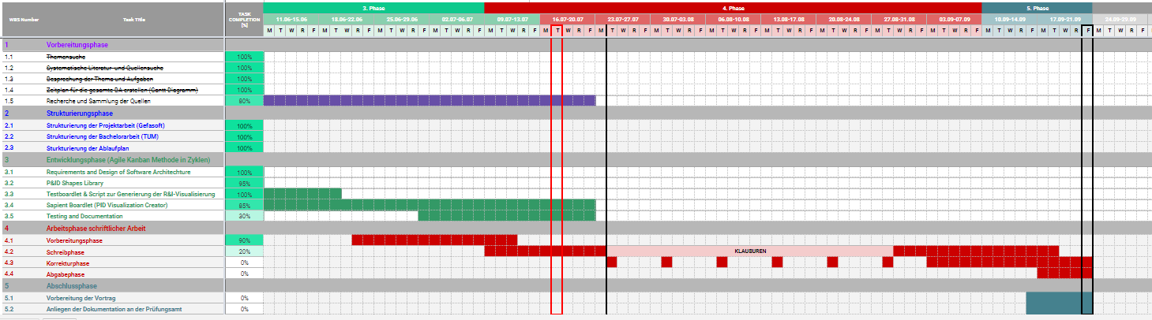
Project – Overview Overview of tasks: Week 10

Slide 86
forEach vertex in pidVertices:
if (not group):
calculate cell area
store cell area
position current vertex:
get previous vertex position (x, y values)
apply positioning rules
set current vertex position
update value of previous x, y values
else if (group):
sum areas of contained cells

Slide 87
Dynamic Generation of Modular Industrial Plant Visualizations
Weekly Meeting 15
Miguel Romero Karam

Slide 88
P&ID Viewer - Dashboard

Slide 89
Sapient Boardlet Weekly Sprint 15

Slide 90
Boardlet Design Updates & Fixes
Implemented progress bar for vertex placement algorithm (can change to any function with iteration)
Fixed responsive layout of buttons when wrapped (narrow mobile screens)
1) on start
2) in progress
3) done
desktop
mobile

Slide 91
Data Bindings Overview
IDs of current values (primary key of p_values_current) stored in prj_prc_pro_flows under rate_value
Why are there only current values for flows ???
Only nodes with process variables have entry in p_values_current ???
Concept (getDataBindings):
Fetch IDs under rate_value along with query for pidConnections – done
For each ID: fetch and join p_values_config and p_values_current – done
Construct a sapientBind object for each rate_value depending on value type
ToDo:
Define data types: each data type (bool/int/float/string…) will have own sapientBind object for Example:
boolean (sets fillColor)
int (sets label) – concept because currently only bools
OR

Slide 92
Data Bindings Overview
boolean (sets fillColor)
int (sets label) – concept because currently only bools
OR

Slide 93
Database Queries Overview Overview: Data Map
fetched
not needed (Legato Graphic Designer fetches current_values automatically with the ID) and current value will be the first non-blank value_[type] field
prj_prc_visu_vertices
l_nodes
p_value_relations
p_values_config
p_values_current
id [PK] : Int
id [PK] : Int
Maps to
id [PK] : Int
id [PK] : Int
id [PK] : Int
node : Int
node_level : Int
node: Int
value_type : Int
value_bool : Int
shape_name : String
node_type : Int
value: Int
value_format: Int
value_num : Double
is_instrument : Boolean
parent : Int
…
name: String
value_str : String
pid_label : String
short_name : String
value_symbol: String
value_date : Timestamp
pid_function : String
name : String
prj_prc_pro_flows
unit: Int
time_stamp : Timestamp
pid_number : String
description_0 : String
…
last_archive_id : Int
description_1 : String
id [PK] : Int
last_update : Timestamp
visuVertices query
node0 : Int
permissions : Int
…
attr_jsonb : Jsonb
node1 : Int
name_0
modelId : Int
port0 : Int
TODO
Complex query to also get this together
p_value_types
isaLevel : String
port1 : Int
DoState
valPrefix : String
product : Int
AoState
id [PK] : Int
standingData: Array
is_continuous : Boolean
DiSens
name : String
opcUALevel : Int
rate_value : Int
AiSens
…
opcUANamespaceName : String
flow_type : String
AiValue
AiTemp
sys_units
opcUAAddressPrefix : String
pidConnections query
…
id [PK] : Int
TODO
COMPARAR CON nameMappings en getData Y ACTUALIZAR SI HACE FALTA
unit_symbol : String
name : String
lNodes query
factor : String
…
…

Slide 94
lNodes and dataBindings Data Map of Query
not needed (Legato Graphic Designer fetches current_values automatically with the ID)
l_nodes
p_value_relations
p_values_config
p_values_current
id [PK] : Int
Maps to
id [PK] : Int
id [PK] : Int
id [PK] : Int
node_level : Int
node: Int
value_type : Int
value_bool : Int
node_type : Int
value: Int
value_symbol: String
value_num : Double
parent : Int
…
name_0: String
value_str : String
short_name : String
value_format: Int
value_date : Timestamp
name_0 : String
unit: Int
time_stamp : Timestamp
name_1 : String
…
last_archive_id : Int
description_0 : String
last_update : Timestamp
description_1 : String
…
permissions : Int
prj_prc_visu_vertices
attr_jsonb : Jsonb
p_value_types
modelId : Int
name_0
id [PK] : Int
isaLevel : String
node : Int
id [PK] : Int
valPrefix : String
DoState
shape_name : String
name_0 : String
standingData: Array
AoState
is_instrument : Boolean
…
opcUALevel : Int
DiSens
pid_label : String
opcUANamespaceName : String
AiSens
pid_function : String
opcUAAddressPrefix : String
AiValue
pid_number : String
…
AiTemp
lNodes query

Slide 95
pidNodes PostgreSQL Query
Complex PostgreSQL query for all data:
SELECT n.id, n.node_level AS nodeLevel, n.parent AS parentId, n.short_name AS shortName, n.name_0 AS name, n.attr_jsonb AS details,
v.id AS vId, v.is_instrument AS isInstrument, v.shape_name AS shapeName, v.pid_label AS pidLabel, v.pid_function AS pidFunction, v.pid_number AS pidNumber,
c.id AS cValueId,
t1.name_0 AS tValueType,
t2.name_0 AS tValueFormat,
u.unit_symbol_0 AS uUnitSymbol, u.name_0 AS uName, u.factor AS uFactor
FROM sapient_owner.l_nodes AS n
LEFT JOIN sapient_owner.prj_prc_visu_vertices AS v ON n.id = v.node
LEFT JOIN sapient_owner.p_value_relations AS r ON n.id = r.node
LEFT JOIN sapient_owner.p_values_config AS c ON r.value = c.id
LEFT JOIN sapient_owner.p_value_types AS t1 ON c.value_type = t1.id
LEFT JOIN sapient_owner.p_value_types AS t2 ON c.value_format = t2.id
LEFT JOIN sapient_owner.sys_units AS u ON c.unit = u.id
WHERE n.id >= 21691 AND n.id <= 21747
ORDER BY n.id ASC

Slide 96
Database Queries Nodes Query - Problem
SQL- Query:
Complex SQL Query with LEFT JOIN not possible with getRecords options
Workaround with javascript:
2 distinct queries
Left Join Function in javascript on common attribute.
prj_prc_visu_vertices
l_nodes
id [PK] : Int
id [PK] : Int
node : Int
node_level : Int
shape_name : String
node_type : Int
is_instrument : Boolean
parent : Int
pid_label : String
short_name : String
pid_function : String
name_0 : String
pid_number : String
name_1 : String
description_0 : String
l_nodes
description_1 : String
Wanted Query Data
permissions : Int
attr_jsonb : Jsonb
visu_vertices
modelId : Int
isaLevel : String
valPrefix : String
standingData: Array
opcUALevel : Int
opcUANamespaceName : String
opcUAAddressPrefix : String
…
LEFT JOIN
ON tree.id = vertex.node

Slide 97
pidConnections Data Map of Query
l_nodes
prj_prc_pro_flows
id [PK] : Int
id [PK] : Int
node_level : Int
node0 : Int
node_type : Int
node1 : Int
parent : Int
port0 : Int
short_name : String
port1 : Int
name_0 : String
product : Int
name_1 : String
is_continuous : Boolean
description_0 : String
rate_value : Int
UPDATE FOR ACTUAL QUERY
description_1 : String
flow_type : String
permissions : Int
pidConnections query
attr_jsonb : Jsonb
modelId : Int
isaLevel : String
valPrefix : String
standingData: Array
opcUALevel : Int
opcUANamespaceName : String
opcUAAddressPrefix : String
…

Slide 98
pidConnections PostgreSQL Query
Complex PostgreSQL query for all data:
SELECT f.id, f.node0 AS sourceId, f.node1 AS targetId, f.port0 AS sourcePort, f.port1 AS targetPort, f.is_continuous AS isContinuous, f.flow_type AS flowType,
p.symbol AS pProduct,
c.id AS cValueId,
t1.name_0 AS tValueType,
t2.name_0 AS tValueFormat,
u.unit_symbol_0 AS uUnitSymbol, u.name_0 AS uName, u.factor AS uFactor
FROM sapient_owner.prj_prc_pro_flows AS f
LEFT JOIN sapient_owner.pro_products AS p ON f.id = p.id
LEFT JOIN sapient_owner.p_values_config AS c ON f.rate_value = c.id
LEFT JOIN sapient_owner.p_value_types AS t1 ON c.value_type = t1.id
LEFT JOIN sapient_owner.p_value_types AS t2 ON c.value_format = t2.id
LEFT JOIN sapient_owner.sys_units AS u ON c.unit = u.id
ORDER BY f.id ASC

Slide 99
visuVertices PostgreSQL Query
Query all flows:
SELECT * FROM sapient_owner.prj_prc_pro_flows
[ORDER BY id ASC]
Then in mapConnectionsToShapes():
Filter:
keep connections only if both target and id found in filtered vertices
Simplify:
Clear waypoints/wayports of edges (ex. shape1 --> group1 --> group2 --> shape2 simplified to shape1 --> shape1)
Map to shapes:
set shapeName property and map to corresponding edge shape in pid shapes library

Slide 100
Vertex Placement Algorithm Overview
Simplification of edges (clear connection waypoints between various edges if any)
Jump
Constraint specification in the form of tags
Positioning logic in the form of rules (depending on tags)
Setting of parameters
forEach vertex in pidVertices:
if (not group):
calculate cell area
store cell area
position current vertex:
get previous vertex position (x, y values)
apply positioning rules
set current vertex position
update value of previous x, y values
else if (group):
sum areas of contained cells

Slide 101
1. Simplification of Edges Overview
forEach edge in pidEdges:
if (already simplified):
skip
else if ()
calculate cell area
store cell area
position current vertex:
get previous vertex position (x, y values)
apply positioning rules
set current vertex position
update value of previous x, y values
else if (group):
sum areas of contained cells

Slide 102
Line Jumps Example:
Problem:
Connections gehen vom Vertexmittelpunk zum Vertexmittelpunk
Connections werden automatisch optimiert um Kreuzungen zu vermindern aber unmöglich alle zu vermeiden
Dies führt zum Zusammenklappen verschiedene linen
Unübersichtlich
Lösung:
Line jumps
Arc form
radius 20pt

Slide 103
2. Constraint Specification Overview
Positioning Rules based on shape attributes:
Tags:

Slide 104
3. Vertex Placement Concept
Probleme:
Inkonsistenzen in das Model (Instance Hierarchy) wie z.B. Gruppen die Gruppen aber auch Shapes enthalten.
Führt zu Irreguläre Platzierung in die Mehrheit der Fälle → braucht zu viel Logik.
Relative positionierung deswegen manchmal suboptimal, aber trotzdem die beste Alternative
Viel Aufwand und wenig Fortschritt bei der Verbesserung des Algorithmus.
Lösungen (zum Teil):
Specification of Constraints erlaubt Logik gezielt zu programmieren
Constraints erlauben auch das progressive Enhancement
Block packing algorithm ist eine optimale Lösung für P&ID Diagramme falls alle children Gruppen sind (rechteckige Blocks). Nicht aber für shapes.

Slide 105
3.1 Placement Logic Example:
Kleine Modifikationen zum vorherigen Logik
Sonst gleich

Slide 106
3.2 packBlocks() Overview
Binary tree block packing algorithm (for groups):
Sort blocks (clones) based on selected sortOrder option (none, width, height, area, maxSide)
Place first (root) block at (0, 0).
Place next block either right or bellow of previous (minimize area)
Repeat 3 until all blocks placed.
Update properties in original objects.
Sehr gute Ergebnisse für Blocks die nur Groupen sind (ohne Shapes)

Slide 107
3.2 packBlocks() Sort Order Options
Beispiel mit 4 Units in Brewery (block dimensions to scale)
by height
none (default)
by area
by width
by maxSide

Slide 108
3.2 Bugs in Boardlet Algorithmus Sort Order Options
Obwohl praktish identische Code, nicht gleiche Visu Output.
Testing Boardlet Sapient Boardlet

Slide 109
Vertex Placement Concept
Geometry between neighbouring children
$$x=w_{p}+s$$
y$=h_{p}−$ $h_{n}$
wn/2
Optimal Fall (vor ein Paar Wochen):
wp/2
(x, y)
hn/2
hp/2
(0, 0)
spacing
Hgmax (currently)
Wgmax (currently)
Relative Positioning
vertex placement group placement group placement … (recursively)
Parent vertex
(0, 0)
(-0.5,0.5)
(0.5, 0.5)
(1, 1)

Slide 110
3.3 Issues and Challenges Weekly Sprint 14
Stillstand beim vertexPlacement Algorithmus → fix bugs, then leave as is
Alles wofür es eine bestimmte Logik dahinter gibt, wird schon entsprechend dieser Logik platziert.
Nich viel mehr Logik um das Platzierungsalgorithmus in wenig Zeit noch zu verbessern.
Verbesserungen machen manchmal andere Teilen von Code kaputt.
Bugs im Algorithmus in Boardlet Script (nicht im Testing Boardlet).
Vorteile:
Konzentration auf Data-bindings (dynamisierung)
Verteci schon ziemlich gut platziert und edges vereinfacht
Verbesserungsmöglichkeiten direkt im draw.io (Drag&Drop)
Nachteile:
Platzierung ist das Endergebniss und alles was man am Ende sieht
Arbeit und Aufwand die hinter die Visualisierung sieht man nicht
Kann zu enttäuschenden Schlussfolgerungen bezüglich des Projekts führen
Bug wenn selectierte rootNode nicht AidaCruises → fix
Animations und Data Bindings
Process Variables noch nicht im Datenbank vorhanden → Animationen nur als Konzept
Model wird sowieso nur booleans enthalten → Konzept für andere Data Types oder nicht ?

Slide 111
Vorläufige Inhaltsverzeichnis Bachelorarbeit
In Word…

Slide 112
Project – Overview Overview of tasks: Week 10

Slide 113
forEach vertex in pidVertices:
if (not group):
calculate cell area
store cell area
position current vertex:
get previous vertex position (x, y values)
apply positioning rules
set current vertex position
update value of previous x, y values
else if (group):
sum areas of contained cells

Slide 114
Dynamic Generation of Modular Industrial Plant Visualizations
Weekly Meeting 15
Miguel Romero Karam

Slide 115
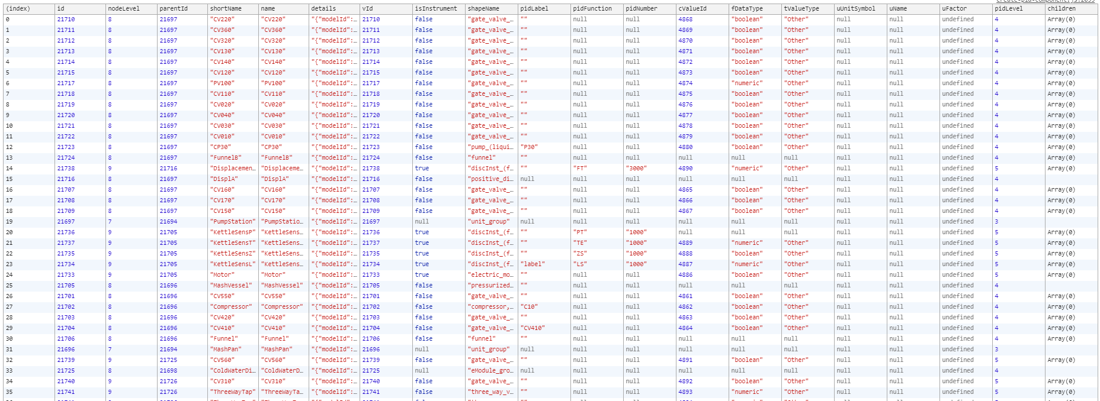
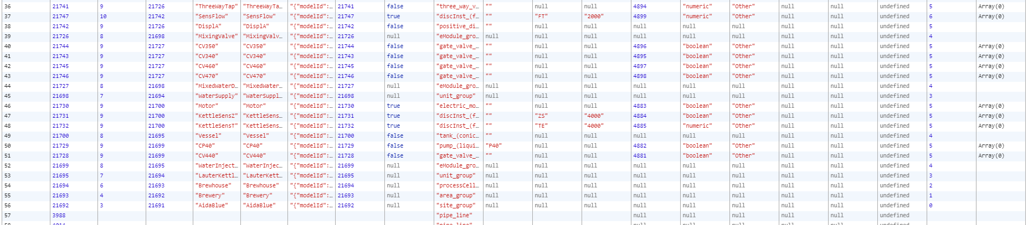
. . .

Slide 116
P&ID Viewer - Dashboard

Slide 117
Sapient Boardlet Weekly Sprint 15

Slide 118
Boardlet Design Updates & Fixes
Implemented progress bar for vertex placement algorithm (can change to any function with iteration)
Fixed responsive layout of buttons when wrapped (narrow mobile screens)
1) on start
2) in progress
3) done
desktop
mobile

Slide 119

Variables for Vertices Name Mappings

Slide 120

Variables for Connections Name Mappings

Slide 121
Data Bindings Overview
boolean (sets fillColor)
int (sets label) – concept because currently only bools
OR

Slide 122
p_value_types
prj_prc_visu_vertices
p_value_relations
p_values_config
l_nodes
id [PK] : Int
id [PK] : Int
id [PK] : Int
id [PK] : Int
t1_name : String
node : Int
id [PK] : Int
node: Int
value_type : Int
t2_name : String
shape_name : String
node_level : Int
value: Int
value_format: Int
…
is_instrument : Boolean
parent : Int
…
name: String
pid_label : String
short_name : String
value_symbol: String
sys_value_formats
pid_function : String
name : String
prj_prc_pro_flows
unit: Int
id [PK] : Int
pid_number : String
attr_jsonb : Jsonb
id [PK] : Int
…
name_1 : String
modelId : Int
node0 : Int
…
isaLevel : String
node1 : Int
valPrefix : String
port0 : Int
pro_products
sys_units
Key:
standingData: Array
port1 : Int
id [PK] : Int
Key:
id [PK] : Int
- pidNodes
- pidConnections
- both
opcUALevel : Int
product : Int
symbol : String
unit_symbol : String
opcUANamespaceName : String
is_continuous : Boolean
…
name : String
opcUAAddressPrefix : String
rate_value : Int
factor : String
…
…
flow_type : String
…

Slide 123
lNodes and dataBindings Data Map of Query
not needed (Legato Graphic Designer fetches current_values automatically with the ID)
l_nodes
p_value_relations
p_values_config
p_values_current
id [PK] : Int
Maps to
id [PK] : Int
id [PK] : Int
id [PK] : Int
node_level : Int
node: Int
value_type : Int
value_bool : Int
node_type : Int
value: Int
value_symbol: String
value_num : Double
parent : Int
…
name_0: String
value_str : String
short_name : String
value_format: Int
value_date : Timestamp
name_0 : String
unit: Int
time_stamp : Timestamp
name_1 : String
…
last_archive_id : Int
description_0 : String
last_update : Timestamp
description_1 : String
…
permissions : Int
prj_prc_visu_vertices
attr_jsonb : Jsonb
p_value_types
modelId : Int
name_0
id [PK] : Int
isaLevel : String
node : Int
id [PK] : Int
valPrefix : String
DoState
shape_name : String
name_0 : String
standingData: Array
AoState
is_instrument : Boolean
…
opcUALevel : Int
DiSens
pid_label : String
opcUANamespaceName : String
AiSens
pid_function : String
opcUAAddressPrefix : String
AiValue
pid_number : String
…
AiTemp
lNodes query

Slide 124
pidNodes PostgreSQL Query
Complex PostgreSQL query for all data:
SELECT n.id, n.node_level AS nodeLevel, n.parent AS parentId, n.short_name AS shortName, n.name_0 AS name, n.attr_jsonb AS details,
v.id AS vId, v.is_instrument AS isInstrument, v.shape_name AS shapeName, v.pid_label AS pidLabel, v.pid_function AS pidFunction, v.pid_number AS pidNumber,
c.id AS cValueId,
t1.name_0 AS tValueType,
t2.name_0 AS tValueFormat,
u.unit_symbol_0 AS uUnitSymbol, u.name_0 AS uName, u.factor AS uFactor
FROM sapient_owner.l_nodes AS n
LEFT JOIN sapient_owner.prj_prc_visu_vertices AS v ON n.id = v.node
LEFT JOIN sapient_owner.p_value_relations AS r ON n.id = r.node
LEFT JOIN sapient_owner.p_values_config AS c ON r.value = c.id
LEFT JOIN sapient_owner.p_value_types AS t1 ON c.value_type = t1.id
LEFT JOIN sapient_owner.p_value_types AS t2 ON c.value_format = t2.id
LEFT JOIN sapient_owner.sys_units AS u ON c.unit = u.id
WHERE n.id >= 21691 AND n.id <= 21747
ORDER BY n.id ASC
UPDATE FOR ACTUAL QUERY

Slide 125
pidConnections Data Map of Query
l_nodes
prj_prc_pro_flows
id [PK] : Int
id [PK] : Int
node_level : Int
node0 : Int
node_type : Int
node1 : Int
parent : Int
port0 : Int
short_name : String
port1 : Int
name_0 : String
product : Int
name_1 : String
is_continuous : Boolean
description_0 : String
rate_value : Int
UPDATE FOR ACTUAL QUERY
description_1 : String
flow_type : String
permissions : Int
pidConnections query
attr_jsonb : Jsonb
modelId : Int
isaLevel : String
valPrefix : String
standingData: Array
opcUALevel : Int
opcUANamespaceName : String
opcUAAddressPrefix : String
…

Slide 126
pidConnections PostgreSQL Query
Complex PostgreSQL query for all data:
SELECT f.id, f.node0 AS sourceId, f.node1 AS targetId, f.port0 AS sourcePort, f.port1 AS targetPort, f.is_continuous AS isContinuous, f.flow_type AS flowType,
p.symbol AS pProduct,
c.id AS cValueId,
t1.name_0 AS tValueType,
t2.name_0 AS tValueFormat,
u.unit_symbol_0 AS uUnitSymbol, u.name_0 AS uName, u.factor AS uFactor
FROM sapient_owner.prj_prc_pro_flows AS f
LEFT JOIN sapient_owner.pro_products AS p ON f.id = p.id
LEFT JOIN sapient_owner.p_values_config AS c ON f.rate_value = c.id
LEFT JOIN sapient_owner.p_value_types AS t1 ON c.value_type = t1.id
LEFT JOIN sapient_owner.p_value_types AS t2 ON c.value_format = t2.id
LEFT JOIN sapient_owner.sys_units AS u ON c.unit = u.id
ORDER BY f.id ASC
UPDATE FOR ACTUAL QUERY

Slide 127
3. Vertex Placement Concept
Probleme:
Leere attribute
Führt zu Irreguläre Platzierung in die Mehrheit der Fälle → braucht zu viel Logik.
Relative positionierung deswegen manchmal suboptimal, aber trotzdem die beste Alternative
Viel Aufwand und wenig Fortschritt bei der Verbesserung des Algorithmus.
Lösungen (zum Teil):
Specification of Constraints erlaubt Logik gezielt zu programmieren
Constraints erlauben auch das progressive Enhancement
Block packing algorithm ist eine optimale Lösung für P&ID Diagramme falls alle children Gruppen sind (rechteckige Blocks). Nicht aber für shapes.

Slide 128
3.1 Placement Logic Example:
Kleine Modifikationen zum vorherigen Logik
Sonst gleich

Slide 129
3.2 packBlocks() Overview
Binary tree block packing algorithm (for groups):
Sort blocks (clones) based on selected sortOrder option (none, width, height, area, maxSide)
Place first (root) block at (0, 0).
Place next block either right or bellow of previous (minimize area)
Repeat 3 until all blocks placed.
Update properties in original objects.
Sehr gute Ergebnisse für Blocks die nur Groupen sind (ohne Shapes)

Slide 130
3.2 packBlocks() Sort Order Options
Beispiel mit 4 Units in Brewery (block dimensions to scale)
by height
none (default)
by area
by width
by maxSide

Slide 131
3.2 Bugs in Boardlet Algorithmus Sort Order Options
Obwohl praktish identische Code, nicht gleiche Visu Output.
Testing Boardlet Sapient Boardlet

Slide 132
Vertex Placement Concept
Geometry between neighbouring children
$$x=w_{p}+s$$
y$=h_{p}−$ $h_{n}$
Optimal Fall (vor ein Paar Wochen):
w_{n}/2
w_{p}/2
(x, y)
h_{n}/2
h_{p}/2
(0, 0)
spacing
H_{g_max} (currently)
W_{g_max} (currently)
Relative Positioning
vertex placement group placement group placement … (recursively)
Parent vertex
(0, 0)
(-0.5,0.5)
(0.5, 0.5)
(1, 1)

Slide 133
3.3 Issues and Challenges Weekly Sprint 14
Stillstand beim vertexPlacement Algorithmus → fix bugs, then leave as is
Alles wofür es eine bestimmte Logik dahinter gibt, wird schon entsprechend dieser Logik platziert.
Nich viel mehr Logik um das Platzierungsalgorithmus in wenig Zeit noch zu verbessern.
Verbesserungen machen manchmal andere Teilen von Code kaputt.
Bugs im Algorithmus in Boardlet Script (nicht im Testing Boardlet).
Vorteile:
Konzentration auf Data-bindings (dynamisierung)
Verteci schon ziemlich gut platziert und edges vereinfacht
Verbesserungsmöglichkeiten direkt im draw.io (Drag&Drop)
Nachteile:
Platzierung ist das Endergebniss und alles was man am Ende sieht
Arbeit und Aufwand die hinter die Visualisierung sieht man nicht
Kann zu enttäuschenden Schlussfolgerungen bezüglich des Projekts führen
Bug wenn selectierte rootNode nicht AidaCruises → fix
Animations und Data Bindings
Process Variables noch nicht im Datenbank vorhanden → Animationen nur als Konzept
Model wird sowieso nur booleans enthalten → Konzept für andere Data Types oder nicht ?

Slide 134
Vorläufige Inhaltsverzeichnis Bachelorarbeit
In Word…

Slide 135
Project – Overview Overview of tasks: Week 10

Slide 136
forEach vertex in pidVertices:
if (not group):
calculate cell area
store cell area
position current vertex:
get previous vertex position (x, y values)
apply positioning rules
set current vertex position
update value of previous x, y values
else if (group):
sum areas of contained cells

